Slide 1

Zero Suicide Team Leaders
Beaver County
2/25/2022

Slide 2

Today’s Agenda
Minutes
Community Connect Program
Partner Updates
GLS Zero Suicide Learning Collaborative
May- Mental Health Awareness Month
Marketing and Community Outreach Team
Trainings
Next Meeting
Resources

Slide 3
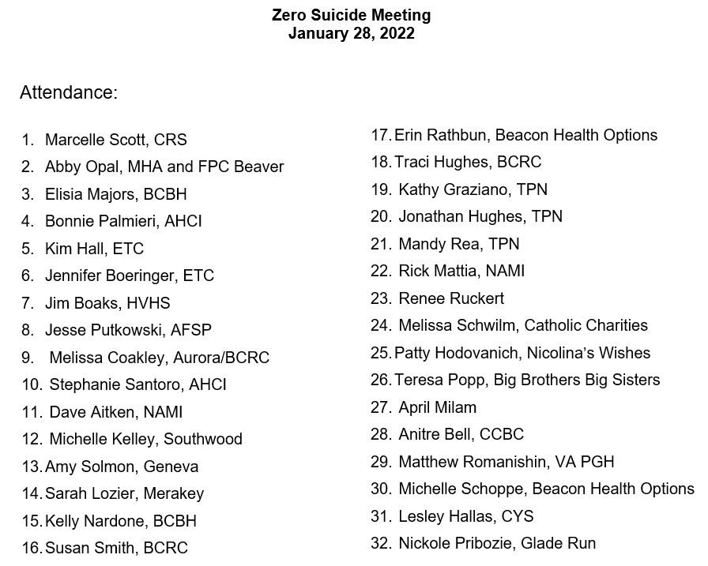


1.28.22 PowerPoint
http://www.bc-systemofcare.org/zero-suicide/
Please use this PowerPoint as the minutes from last meeting

Slide 4
Welcome MHA
Dennis Thunberg
Community Connect Coordinator
Mental Health Association
105 Brighton Avenue
Rochester, PA. 15074
Phone: 724-775-4165

Slide 5

COMMUNITY CONNECT TRANSPORTATION PROGRAM
How Community Connect works:
• Transportation requests are made through behavioral health providers. If you do not have a case manager or treatment team, call us directly.
• The Community Connect Coordinator will verify name, address, phone number, as well as the date, time, and location where transport is needed.
• 24-hour notice is required to ensure ride availability. Last minute requests will be considered, but not guaranteed.
• Transportation is provided to grocery stores, medical appointments, court hearings, and other community sites. All requests will be considered.
Transportation touches many aspects of a person’s life, making adequate and reliable transportation services fundamental to healthy lives and strong communities. Community Connect helps individuals and families by helping to resolve transportation barriers that hinders the accessing of vital care and basic life necessities.
This service is provided at NO COST to you. TO CONTACT THE COMMUNITY CONNECT COORIDINATOR CALL
724-775-4165.

Slide 6
PARTNER UPDATES

Slide 7


VA Pittsburgh Health Care System
Suicide Prevention Program
Notes:
going on right now is the S.A.V.E training 3/8/22 1-3 (see attached flier) for any caregivers or Veterans) It’s a free event. There was the notice of that training that Bree sent out the other day (Preventing Suicide Through Safety Planning and Lethal Means Safety) that I believe I saw you on the email. Those are the only two new things. The constant are if anyone needs gun locks they can reach out to me and I can see if we are able to provide them, we can typically provide large quantities of them. As well as we are a referral source if they have a Veteran they are concerned about and would like to see if we can get them connected to VA Care.

Slide 8
VA Pittsburgh
Health Care System
Suicide Prevention Program
Preventing Suicide Through Safety Planning and Lethal Means Safety Program Description: The purpose of this recorded, knowledge-based training is to provide health care teams with key data and research updates on the national problem of Veteran suicide. This training will provide clinical resources and tools providers can use to implement lethal means safety counseling and suicide prevention safety plans when working with Veterans, along with identifying the most common lethal means of suicide within the Veteran population. Location: VHA TRAIN Access links: Non-VA employees click here. VA employees click here. Audience: Physicians, psychologists, nurses, social workers, physician assistants and pharmacists Modality: On-demand video Credit/hours: 1 Accreditations: AAPA, ACCME, ACCME-NP, ACPE, ANCC, APA, ASWB, JA IPCE, NYSED SW, NYSED-P Questions?: If you require assistance, please contact the VHA TRAIN Help Desk by email at VHATRAIN@va.gov.

Slide 9
American Foundation for Suicide Prevention
We have our State Capitol Day planned as a virtual event for March 21st.
The link to register is: https://pastatecapitol2022.attendease.com/
We also have campus walks coming up starting the first weekend of April at the University of Pittsburgh, Robert Morris University, Chatham University, Waynesburg University, and Duquesne University.

Slide 10


YAP (Youth Ambassador Program)
Planning committee is conducting outreach to various schools
YAP students are presenting at the DOH Health Equity Summit on April 7th
How does YAP address mental health inequities?
YAP county-wide event scheduled April 20th!!!!
Will be seeking county partners to table and share resources with the youth

Slide 11

StepUP
Some exciting changes happening this year that will benefit the youth and young adults
Camp will include:
Traditional activities
Other opportunities in the community and service learning options
Independent living skills (example: credit, taxes, balancing a check book)
Session 1: Dates will be June 13th through July 8th.
Session 2: Dates will be July 11th through August 5th.
School-based mentoring can occur with youth on an as-needed basis. We primarily have staff assisting with that this year rather than volunteers. This can be a virtual service as well based on the needs of the school and the students.

Slide 12
NAMI
Seeking volunteers to help with meeting facilitation and trainings.
Rising Stars
Our young adult group is still going strong.
Meetings are held on Thursday nights from 7pm to 9pm
We are looking to reach out to the local colleges to have their students who may need an outlet or a friend become involved in the group.

Slide 13

Register by clicking below link:
https://docs.google.com/forms/d/e/1FAIpQLSfZiBAs9d9oQdGj1qUZ4wiKfgxEmA2eEEgfvTGlHPk9M39b9A/viewform

Slide 14
Other Updates

Slide 15

Garrett Lee Smith Youth Suicide Prevention Grant
Held on February 17th
Beaver County was well represented
SAP
Schools
Guidance Counselors
DA’s Office
Behavioral Health Providers
Crisis Services
Vocational Supports
Housing Provider
Next meeting March 17th at 12pm

Slide 16

May- Mental Health ACCEPTANCE Month
What is your organization going to do?

Slide 17
Marketing and Community Outreach and Education Team
Plans for May
Posters
Yard Signs
Trainings
Community Event
Want to join the committee?
Contact Marcy Scott mscott@crscares.org or Elisia Majors emajors@bcbh.org

Slide 18
Beaver County Bounces Back!!!!!
Mental Health Acceptance and Wellness Event!!!!
Mark your calendar!!!!
Tentatively scheduled for: May 21st from 11am-2pm
Where: Brady’s Run Walking Trail
How can you help?
Donate raffle baskets
Sign up to provide a resource and/or vendor tables
Help advertise and promote the event
Assist with day of activities
Family fun activities
Games
Food trucks
Resources
Music

Slide 19

Upcoming Trainings
Additional information and registration information can be found on:
http://www.bc-systemofcare.org/training/

Slide 20


Trainings Available
QPR (Question, Persuade, and Refer)
Virtual or In-person
Youth QPR (Question, Persuade, and Refer)
Virtual or In-person
Mental Health First Aid
Youth Mental Health First Aid
Archived trainings:
BC SOC Youtube:
https://www.youtube.com/channel/UCDKZZQif0q0YIqfBgkEGc4Q
Beacon:
https://www.beaconhealthoptions.com/providers/beacon/important-tools/webinars/archive/
Prevent Suicide PA:
https://www.preventsuicidepa.org/trainings/all-trainings/
www.bc-systemofcare.org/training/

Slide 21

Next meeting
Date: March 25th at 1:30pm
Zoom link will be sent

Slide 22

Check out the website: http://www.bc-systemofcare.org/ Send updates to: SOCwebmaster@ahci.org SOC YouTube channel: https://www.youtube.com/watch?v=GY4rLQJRAcM&list=PL6lF8gWeCfKyHgu4A5RKl1SX7kH2BJrC-&index=2

Slide 23

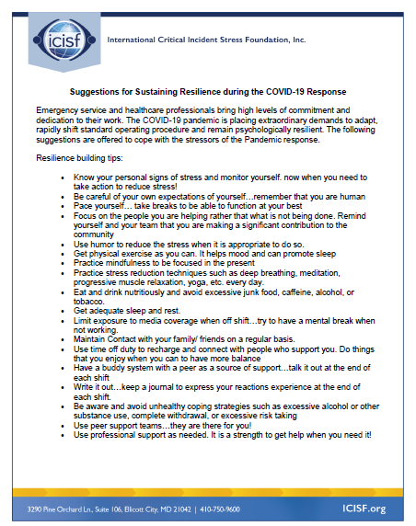



Slide 24

Resources
Please share the following resources with anyone who can benefit

Slide 25
Food Resources
https://www.agriculture.pa.gov/Food_Security/Pages/Resources.aspx
Mental Health Resources
https://www.pa.gov/guides/mental-health/
Unemployment Benefits
https://www.pa.gov/guides/unemployment-benefits/
COVID Testing
https://pema.maps.arcgis.com/apps/webappviewer/index.html?id=1a4c139769d646839e1549bcb6a668f1
COVID Guidance and Resources
https://www.pa.gov/guides/responding-to-covid-19/
Help for Homeowners / Landlords / Renters
https://www.consumerfinance.gov/coronavirus/mortgage-and-housing-assistance/renter-protections/find-help-with-rent-and-utilities/?utm_source=vanity&utm_medium=outreach&utm_campaign=renthelp
PA COVID Resources

Slide 26
Resources
The Mental Health Support Line
Developed on April 1st
Can be reached toll-free, 24/7 at 1-855-284-2494 from anywhere in PA.
Crisis Text Line
Text PA to 741-741
PA Get Help Now Helpline
Can be reached toll-free at 1-800-662-HELP (4357).
A live chat option is also available online or via text message at 717-216-0905
Warmline of Beaver County
Can be reached at 1-877-775-WARM (9276)
Hours of operation 6pm-9pm
UPMC Beaver County Crisis
Can be reached toll-free, 24/7 at 1-800-400-6180

Slide 27
PA Resources
Many other resources also remain available to Pennsylvanians in need of support, including:
National Suicide Prevention Lifeline: 1-800-273-TALK (8255)
Línea Nacional de Prevención del Suicidio: 1-888-628-9454
Crisis Text Line: Text “PA” to 741-741
Safe2Say: 1-844-723-2729 or www.safe2saypa.org
Veteran Crisis Line: 1-800-273-TALK (8255) (Press 1)
Disaster Distress Helpline: 1-800-985-5990
Get Help Now Hotline (for substance use disorders):
1-800-662-4357

Slide 28

What can we do to help?
E-mail us:
Elisia Majors
emajors@bcbh.org
Stephanie Santoro
ssantoro@ahci.org
Bonnie Palmieri
bpalmieri@ahci.org

Slide 29



Thank you!! Stay Well!

