Slide 1

Zero Suicide Team Leaders
Beaver County
3/25/2022

Slide 2

Today’s Agenda
Minutes
Crisis Data
Partner Updates
GLS Zero Suicide Learning Collaborative
May- Mental Health Awareness Month
Marketing and Community Outreach Team
Trainings
Next Meeting
Resources

Slide 3
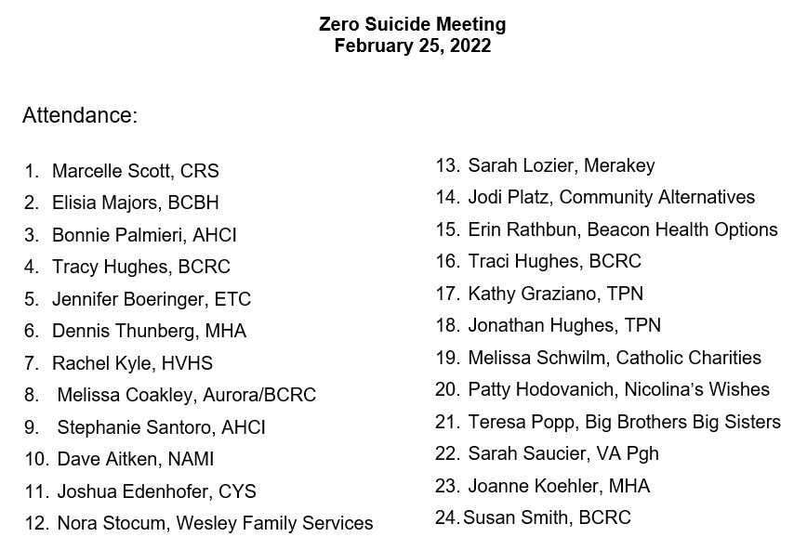


02.25.22 PowerPoint
http://www.bc-systemofcare.org/zero-suicide/
Please use this PowerPoint as the minutes from last meeting

Slide 4
Welcome
Maria Townsend
Zero Suicide Initiative
Crisis Prevention Data

Slide 5
PARTNER UPDATES

Slide 6

Geneva College
Mental Health First Aid
3/19 - great training on campus.
trainers Kim Andrews and Kate Lowery
20 in attendance
The majority of the attendees were college students and 4 staff members
QPR
Hannah Broadway hosted virtual QPR trainings this week for faculty/staff
Sessions were held on 3/22 and 3/24
around 20 registered between the two trainings

Slide 7

American Foundation for Suicide Prevention
Campus Walks getting scheduled.
University of Pittsburgh, Robert Morris University, Chatham University, Waynesburg University, and Duquesne University.
Scheduled listed at https://afsp.org/westernpa
We have several presentations coming up in schools with the It’s Real: Teens and Mental Health program.

Slide 8
MHA
Faith Presbyterian Church
Annual Prom on Wed. evening May 25th from 6-8 PM at Faith Community United Methodist Church
For Mental Health Acceptance Month: a special worship service at FPC Beaver. Tentatively scheduled for 5/22 in the evening
April drop-in center calendar Mystery Trips are in full-swing. They fill up fast, so please contact the MHA in early April.
Let’s Talk About Mental Health – April 23, 2022
(see next 2 slides)

Slide 9
PLEASE REGISTER at: https://www.fpcbeaver.com/fpcbeaver.com/mentalhealthseminar

Slide 10
Mental Health Association
Phoenix Drop In Center

Slide 11


YAP (Youth Ambassador Program)
YAP students are presenting at the DOH Health Equity Summit on April 7th
How does YAP address mental health inequities?
YAP county-wide event scheduled April 20th!!!!
Speakers include Listen Lucy and Caring Place
Will be seeking county partners to table and share resources with the youth
YAP students are planning MH Awareness and Acceptance events for their school districts

Slide 12
Other Updates

Slide 13

Annual Zero Suicide Initiative Survey
Look for the annual survey coming out soon. We will share the link as soon as it’s ready.
Please take the time to complete it in an effort to help support this initiative.

Slide 14



Slide 15

Garrett Lee Smith Youth Suicide Prevention Grant
Held on March 17th
Focused on the essential element: Lead
Beaver County was well represented
SAP
Schools
Behavioral Health Providers
Crisis Services
Vocational Supports
Housing Provider
Next meeting April 21st at 12pm

Slide 16

May- Mental Health ACCEPTANCE Month
What is your organization going to do?

Slide 17
Marketing and Community Outreach and Education Team
Plans for May
Posters
Yard Signs
Trainings
Community Event
Want to join the committee?
Contact Marcy Scott mscott@crscares.org or Elisia Majors emajors@bcbh.org

Slide 18
Beaver County Bounces Back!!!!!
Mental Health Acceptance and Wellness Event!!!!
Mark your calendar!!!!
May 14th from 11am-2pm
Brady’s Run Walking Trail
How can you help?
Donate raffle baskets
Sign up to provide a resource and/or vendor tables
Help advertise and promote the event
Assist with day of activities
Family fun activities
Games
Food trucks
Resources
Music

Slide 19

PLEASE SHARE
PARTICIPATE
VOLUNTEER
DONATE

Slide 20
TRAININGS

Slide 21

Upcoming Trainings
Additional information and registration information can be found on:
http://www.bc-systemofcare.org/training/

Slide 22

Dr. Mandy Fauble will be coming back to the county virtually!
April 8th from 1:30-3:30
Current data on anxiety and other stress related symptoms
Impact of anxiety on day to day life
Identify tools to manage anxious thoughts and behaviors
Identify to assist other
Click here to register:
https://us02web.zoom.us/meeting/register/tZcldu-prjoqHNcBTTWU8-83GPvpHHAU9pRU

Slide 23

Click here to register: https://us02web.zoom.us/meeting/register/tZEkcuGvrz8jGNPUAXJtGTM3Xr4mrm3S0Ogr

Slide 24
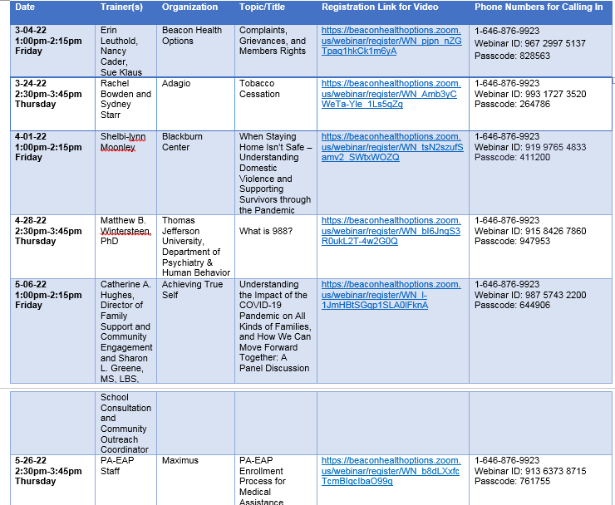
Upcoming Beacon Health Options Trainings

Slide 25

Register by clicking below link:
https://docs.google.com/forms/d/e/1FAIpQLSfZiBAs9d9oQdGj1qUZ4wiKfgxEmA2eEEgfvTGlHPk9M39b9A/viewform

Slide 26


Slide 27


Trainings Available
QPR (Question, Persuade, and Refer)
Virtual or In-person
Youth QPR (Question, Persuade, and Refer)
Virtual or In-person
Mental Health First Aid
Youth Mental Health First Aid
Archived trainings:
BC SOC Youtube:
https://www.youtube.com/channel/UCDKZZQif0q0YIqfBgkEGc4Q
Beacon:
https://www.beaconhealthoptions.com/providers/beacon/important-tools/webinars/archive/
Prevent Suicide PA:
https://www.preventsuicidepa.org/trainings/all-trainings/
www.bc-systemofcare.org/training/

Slide 28

Next meeting
Date: April 22nd at 1:30pm
Zoom link will be sent

Slide 29

Check out the website: http://www.bc-systemofcare.org/ Send updates to: SOCwebmaster@ahci.org SOC YouTube channel: https://www.youtube.com/watch?v=GY4rLQJRAcM&list=PL6lF8gWeCfKyHgu4A5RKl1SX7kH2BJrC-&index=2

Slide 30

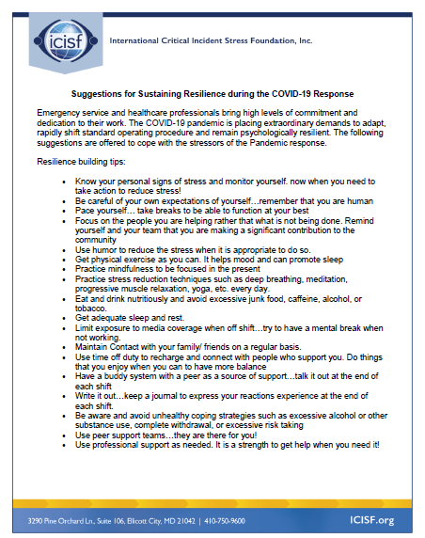



Slide 31

Resources
Please share the following resources with anyone who can benefit

Slide 32
Food Resources
https://www.agriculture.pa.gov/Food_Security/Pages/Resources.aspx
Mental Health Resources
https://www.pa.gov/guides/mental-health/
Unemployment Benefits
https://www.pa.gov/guides/unemployment-benefits/
COVID Testing
https://pema.maps.arcgis.com/apps/webappviewer/index.html?id=1a4c139769d646839e1549bcb6a668f1
COVID Guidance and Resources
https://www.pa.gov/guides/responding-to-covid-19/
Help for Homeowners / Landlords / Renters
https://www.consumerfinance.gov/coronavirus/mortgage-and-housing-assistance/renter-protections/find-help-with-rent-and-utilities/?utm_source=vanity&utm_medium=outreach&utm_campaign=renthelp
PA COVID Resources

Slide 33
Resources
The Mental Health Support Line
Developed on April 1st
Can be reached toll-free, 24/7 at 1-855-284-2494 from anywhere in PA.
Crisis Text Line
Text PA to 741-741
PA Get Help Now Helpline
Can be reached toll-free at 1-800-662-HELP (4357).
A live chat option is also available online or via text message at 717-216-0905
Warmline of Beaver County
Can be reached at 1-877-775-WARM (9276)
Hours of operation 6pm-9pm
UPMC Beaver County Crisis
Can be reached toll-free, 24/7 at 1-800-400-6180

Slide 34
PA Resources
Many other resources also remain available to Pennsylvanians in need of support, including:
National Suicide Prevention Lifeline: 1-800-273-TALK (8255)
Línea Nacional de Prevención del Suicidio: 1-888-628-9454
Crisis Text Line: Text “PA” to 741-741
Safe2Say: 1-844-723-2729 or www.safe2saypa.org
Veteran Crisis Line: 1-800-273-TALK (8255) (Press 1)
Disaster Distress Helpline: 1-800-985-5990
Get Help Now Hotline (for substance use disorders):
1-800-662-4357

Slide 35

What can we do to help?
E-mail us:
Elisia Majors
emajors@bcbh.org
Stephanie Santoro
ssantoro@ahci.org
Bonnie Palmieri
bpalmieri@ahci.org

Slide 36



Thank you!! Stay Well!

