Slide 1

Zero Suicide Team Leaders
Beaver County
1/28/2022

Slide 2

Today’s Agenda
Minutes
Partner Updates
GLS Zero Suicide Learning Collaborative
2020 Data
Trainings
Next Meeting
Resources

Slide 3
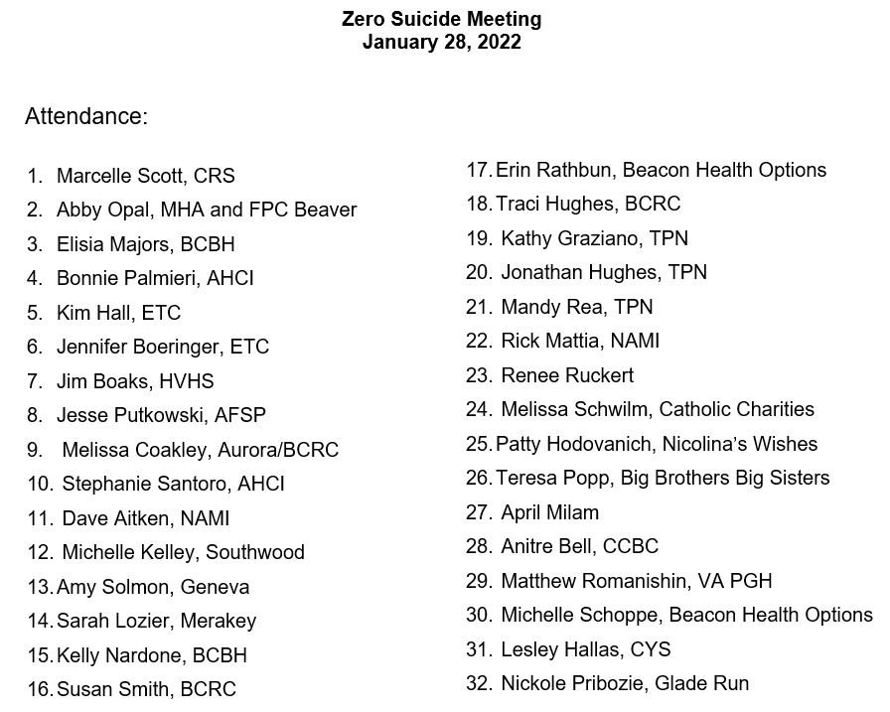


1.28.22 PowerPoint
http://www.bc-systemofcare.org/zero-suicide/
Please use this PowerPoint as the minutes from last meeting

Slide 4
PARTNER UPDATES

Slide 5


Interested in obtaining gun locks?
Contact:
Sarah Saucier, LCSW
Suicide Prevention
412-360-6301
sarah.saucier@va.gov

Slide 6
American Foundation for Suicide Prevention
We have our State Capitol Day planned as a virtual event for March 21st.
  The link to register is: https://pastatecapitol2022.attendease.com/
Our Wisconsin Chapter is hosting a Healing Conversations Info Session. It will be on January 31st at 6pm (CT).
  The link to register is https://wihc1.attendease.com/.
We have a Volunteer 101 Orientation for people who are interested in becoming a volunteer for AFSP. This is on February 16th at 7pm (EST).
  Link: https://wpa101vol222.attendease.com/
February’s virtual presentations will be listed by the 1st of the month at https://afsp.org/westernpa. For February, we will be doing Talk Saves Lives for Workplace Settings and an Introduction to Supporting Those at Risk. Dates are TBD.
We also have campus walks coming up starting the first weekend of April at the University of Pittsburgh, Robert Morris University, Chatham University, Waynesburg University, and Duquesne University.

Slide 7
Mental Wellness Resources for the Agriculture Community
The Pennsylvania Department of Agriculture recognizes that farmers and their families have unique circumstances that may contribute to loneliness, sadness, stress, or depression and hinder someone from seeking professional treatment for their mental health. Living and/or working on a farm can be isolating, rural areas have fewer therapists, and the work on a farm never stops.
Feelings of stress, sadness, numbness or hopelessness are symptoms of depression that should not be ignored. Anyone, at any age, can experience these feelings and deserves treatment.
Families, friends, and community members may notice signs of declining mental health including:
  Decline in care of crops, animals, and farm
  Deterioration of personal appearance
  Withdrawing from social events
  Increase in farm accidents
  Change in routine
  Increased physical complaints
  Increase in alcohol use
  Giving away prized possessions
https://www.agriculture.pa.gov/Pages/Mental_Wellness.aspx#:~:text=The%20Department%20of%20Human%20Services,PA%22%20to%20741%2D741.

Slide 8
Mental Wellness Resources for the Agriculture Community
Pennsylvania livestock producers, as well as agricultural professionals who work directly with these producers, are encouraged to take a short survey to give their insight on mental wellness within the state’s agriculture industry.
The surveys are being conducted as part of a Pennsylvania Department of Agriculture effort, funded by a USDA Farm and Ranch Stress Assistance Network (FRSAN) grant.
Surveys are confidential and anonymous, and individuals are encouraged to answer the questions and submit their responses by Jan. 31. Question topics include issues affecting mental health in the agriculture sector, obstacles for seeking treatment, community support, warning signs about mental health conditions and more.
FRSAN grant partners will use the results of the study to develop a library of mental health resources for the agriculture community and will also be putting together several mental health workshops in the spring. Dates and details for the mental health workshops will be announced soon.
To complete the short surveys, visit centerfordairyexcellence.org to access the digital surveys. If you would like to be mailed a physical copy of the survey, call 717-346-0849 or email info@centerfordairyexcellence.org.

Slide 9
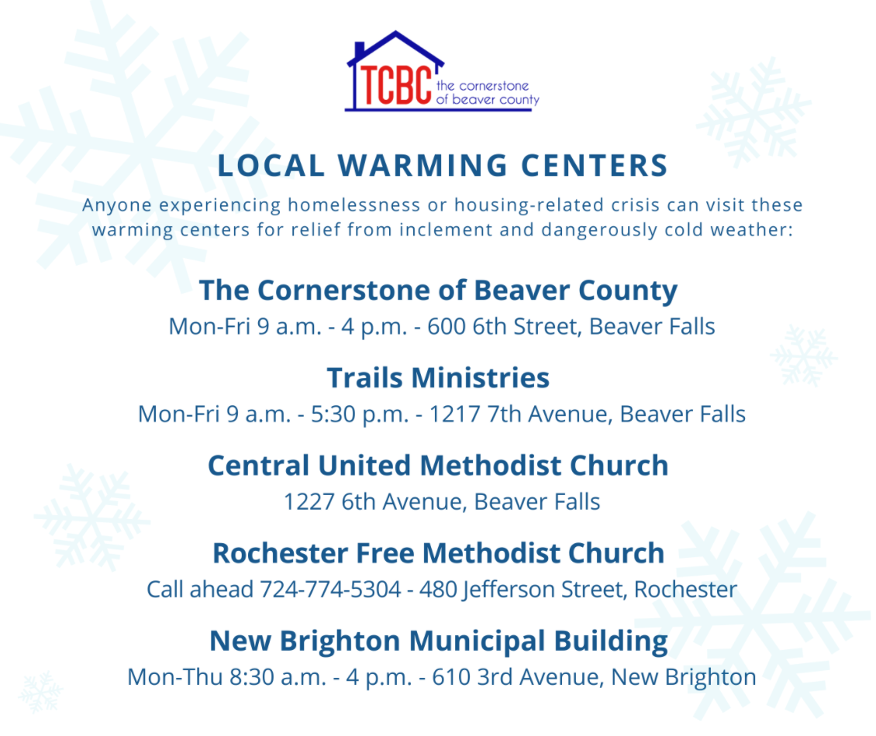
Warming Centers
Please share this information with anyone you know who needs help.
Additional information can be found on the "Resources" page of TCBC on warming centers and basic needs assistance, including food. Here's the link:
https://cornerstonebeaver.org/resources/

Slide 10
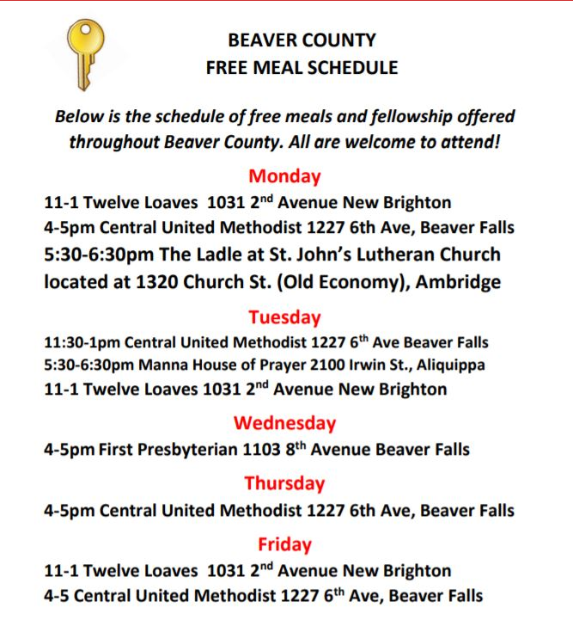
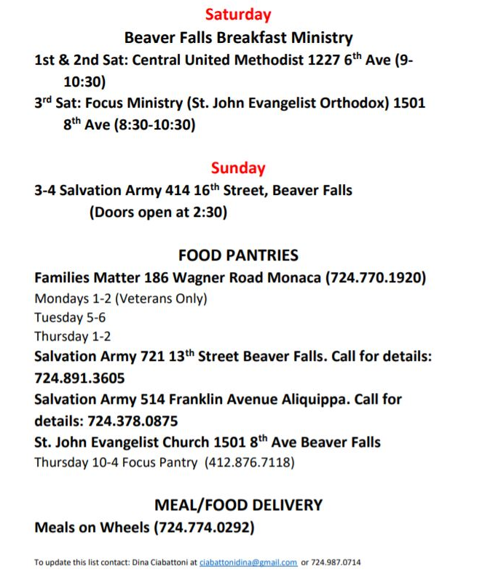

Food Resources
To print: http://www.bc-systemofcare.org/meal-schedule-food-pantries/

Slide 11



YAP (Youth Ambassador Program)
We has been busy visiting different school districts helping them re-establish YAP
Meet and greets
Club meetings
Listening and planning sessions
Meetings with school administration

Slide 12
Other Updates

Slide 13

Garrett Lee Smith
Youth Suicide Prevention Grant

Slide 14
Updated Beaver County Statistics
2016-22 deaths by suicide
2017-25 deaths by suicide
2018-23 deaths by suicide
2019-21 deaths by suicide
2020-25 deaths by suicide
2021-18 deaths by suicide

Slide 15
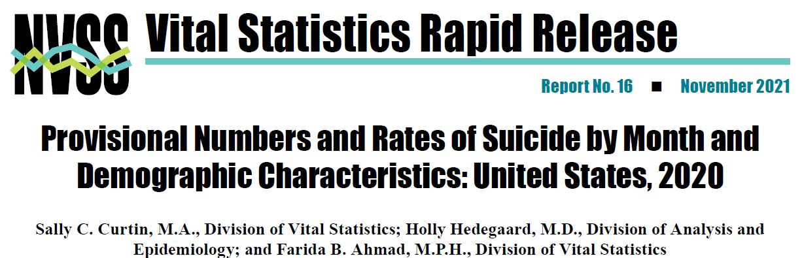
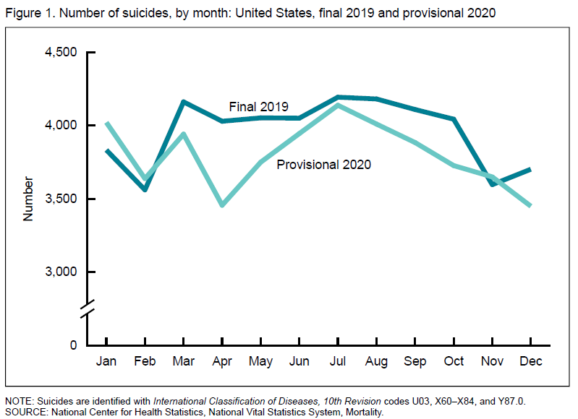
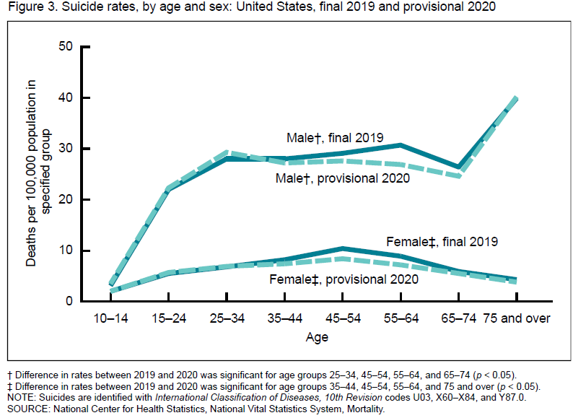
The provisional number of suicides in 2020 (45,855) was 3% lower than in 2019 (47,511). The provisional age-adjusted suicide rate was also 3% lower in 2020 (13.5 per 100,000) than in 2019 (13.9).

Slide 16

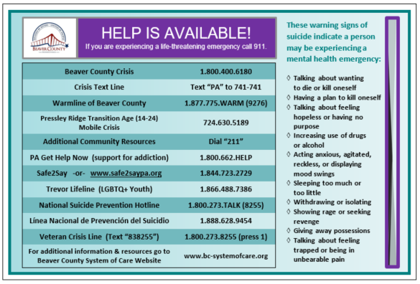
Upcoming Events??
Holiday meals
Gift distributions
Vaccination Clinics
Open houses
Trainings
Winter clothing drives
Don’t forget to include suicide prevention materials
  “It’s OK to Not be OK” resource cards
  Crisis cards
  Beaver County Resource Guides
Contact Elisia Majors to make arrangements
  emajors@bcbh.org

Slide 17


Trainings Available
QPR (Question, Persuade, and Refer)
  Virtual or In-person
Youth QPR (Question, Persuade, and Refer)
  Virtual or In-person
Mental Health First Aid
Youth Mental Health First Aid
Archived trainings:
BC SOC Youtube:
  https://www.youtube.com/channel/UCDKZZQif0q0YIqfBgkEGc4Q
Beacon:
  https://www.beaconhealthoptions.com/providers/beacon/important-tools/webinars/archive/
Prevent Suicide PA:
  https://www.preventsuicidepa.org/trainings/all-trainings/
www.bc-systemofcare.org/training/

Slide 18

Upcoming training opportunity:
Click here to register:
https://us02web.zoom.us/meeting/register/tZ0kd-usrD4qH9boAwAZYCuinmbSytsTMOij

Slide 19

Next meeting
Date: January 28th at 1:30pm
Zoom link will be sent

Slide 20

Check out the website: http://www.bc-systemofcare.org/
Send updates to: SOCwebmaster@ahci.org
SOC YouTube channel: https://www.youtube.com/watch?v=GY4rLQJRAcM&list=PL6lF8gWeCfKyHgu4A5RKl1SX7kH2BJrC-&index=2

Slide 21

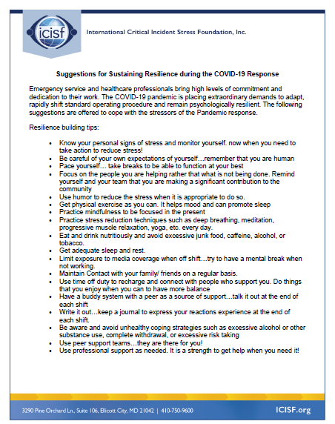



Slide 22

Resources
Please share the following resources with anyone who can benefit

Slide 23

Persevere PA Crisis Counseling Program (CCP) provides SAMHSA approved crisis counseling tele-health services, through the Center for Community Resources (CCR), and can be provided to people who need support related to the impacts of COVID-19. CCR provides the 24/7 Support and Referral Line that delivers the crisis counseling services.

Slide 24
Food Resources
https://www.agriculture.pa.gov/Food_Security/Pages/Resources.aspx
Mental Health Resources
https://www.pa.gov/guides/mental-health/
Unemployment Benefits
https://www.pa.gov/guides/unemployment-benefits/
COVID Testing
https://pema.maps.arcgis.com/apps/webappviewer/index.html?id=1a4c139769d646839e1549bcb6a668f1
COVID Guidance and Resources
https://www.pa.gov/guides/responding-to-covid-19/
Help for Homeowners / Landlords / Renters
https://www.consumerfinance.gov/coronavirus/mortgage-and-housing-assistance/renter-protections/find-help-with-rent-and-utilities/?utm_source=vanity&utm_medium=outreach&utm_campaign=renthelp
PA COVID Resources

Slide 25
Resources
The Mental Health Support Line
Developed on April 1st
Can be reached toll-free, 24/7 at 1-855-284-2494 from anywhere in PA.
Crisis Text Line
Text PA to 741-741
PA Get Help Now Helpline
Can be reached toll-free at 1-800-662-HELP (4357).
A live chat option is also available online or via text message at 717-216-0905
Warmline of Beaver County
Can be reached at 1-877-775-WARM (9276)
Hours of operation 6pm-9pm
UPMC Beaver County Crisis
Can be reached toll-free, 24/7 at 1-800-400-6180

Slide 26
PA Resources
Many other resources also remain available to Pennsylvanians in need of support, including:
  National Suicide Prevention Lifeline: 1-800-273-TALK (8255)
  Línea Nacional de Prevención del Suicidio: 1-888-628-9454
  Crisis Text Line: Text “PA” to 741-741
  Safe2Say: 1-844-723-2729 or www.safe2saypa.org
  Veteran Crisis Line: 1-800-273-TALK (8255) (Press 1)
  Disaster Distress Helpline: 1-800-985-5990
  Get Help Now Hotline (for substance use disorders):
  1-800-662-4357

Slide 27
COVID Resources
https://www.cdc.gov/coronavirus/2019-ncov/daily-life-coping/managing-stress-anxiety.html
https://mhanational.org/covid19
https://psychhub.com/covid-19

Slide 28

What can we do to help?
E-mail us:
Elisia Majors
emajors@bcbh.org
Stephanie Santoro
ssantoro@ahci.org
Bonnie Palmieri
bpalmieri@ahci.org

Slide 29



Thank you!!
Stay Well!

