Slide 1

Zero Suicide Team Leaders
Beaver County
12/10/2021

Slide 2

Welcome!!!! ☺
Today’s meeting
A reminder of how this works
Sign-in
Type your name and organization into the chat box

Slide 3
Today’s Agenda
Minutes
Partner Spotlight
Partner Updates
GLS Newsletter
2020 Provisional Data
Trainings
Next Meeting
Resources

Slide 4
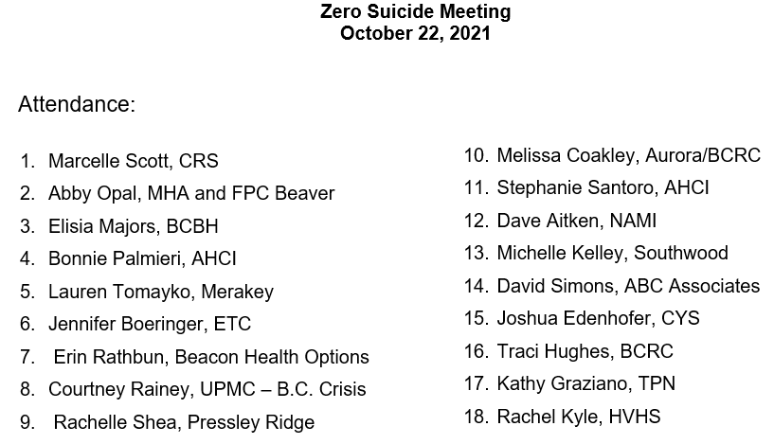


10.22.2021 PowerPoint
http://www.bc-systemofcare.org/zero-suicide/
Please use this PowerPoint as the minutes from last meeting

Slide 5
PARTNER SPOTLIGHT

Slide 6

Staunton Clinic
Annual Staff Training
SAFE-T
CCM
For Clients
PHQ-9 Assessments
Suicide/Homicide Risk Assessments
Wellness Planning
For Staff
Wellness Week (plans to open for clients after COVID-19 restrictions are lifted)
Wellness Challenges
Plans to implement SAFE-R for postvention
In the Community
Beaver County Zero Suicide Committee
Western Behavioral Health Network Suicide Steering Committee
AFSP Out of the Darkness Walk

Slide 7
PARTNER UPDATES

Slide 8
Women’s Center of Beaver County
Victims and survivors of domestic and sexual violence can find the help and hope they need at the Women’s Center of Beaver County. Available 24 hours a day, 7 days a week, call the HELPLINE at (724) 775-0131 or (877) 629-1841
The Women’s Center advocates for ALL victims and survivors of domestic violence and sexual assault without regard to status, race, ethnicity, gender, age, sexual orientation, physical ability, or language.
Services are confidential and provided free of charge: crisis intervention, emergency shelter, counseling, legal and medical advocacy, and prevention education.
Women’s Center Pamphlets:
LGBTQ Intimate Partner Violence
Sexual Violence Protection Orders and Protection from Intimidation Orders
Protection From Abuse (PFA) Pamphlet
Women’s Center “No More” Pocket Card
Women’s Center Child Adolescent Therapy Program
Which Protection Order Process?
Learn more at:
http://www.bc-systemofcare.org/womens-information/

Slide 9

The Cornerstone of Beaver County
WINTER GEAR!
Vaccines & Boosters!
Hygiene Products!
Resources!
See the SOC Website Announcement:
http://www.bc-systemofcare.org/dec-16th-tcbc-drive-up-donation-distribution/

Slide 10

Free Haircuts
https://www.bc-systemofcare.org/free-haircuts-must-make-an-appointment/

Slide 11


Featuring: NAMI - Beaver
http://www.bc-systemofcare.org/nami-beaver-christmas-party-and-other-nami-programs/

Slide 12

NEW at NAMI!
http://www.bc-systemofcare.org/nami-beaver-christmas-party-and-other-nami-programs/

Slide 13


NEW at NAMI!
http://www.bc-systemofcare.org/nami-beaver-christmas-party-and-other-nami-programs/

Slide 14


NEW at NAMI!
http://www.bc-systemofcare.org/nami-beaver-christmas-party-and-other-nami-programs/

Slide 15
Other Updates

Slide 16

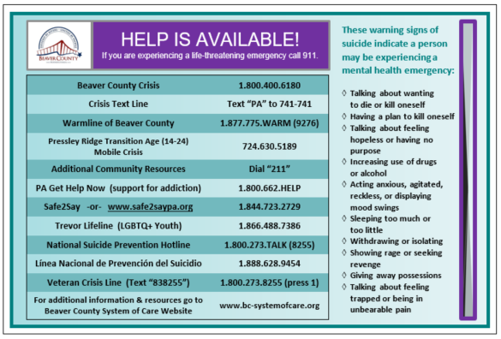
Upcoming Events??
Holiday meals
Gift distributions
Vaccination Clinics
Open houses
Trainings
Winter clothing drives
Don’t forget to include suicide prevention materials
“It’s OK to Not be OK” resource cards
Crisis cards
Beaver County Resource Guides
Contact Elisia Majors to make arrangements
emajors@bcbh.org

Slide 17
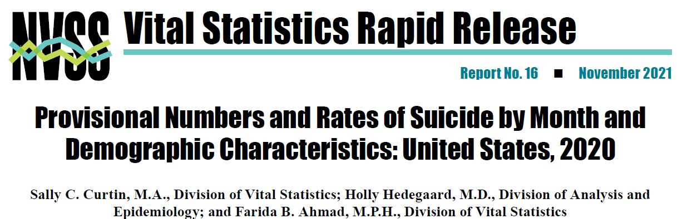
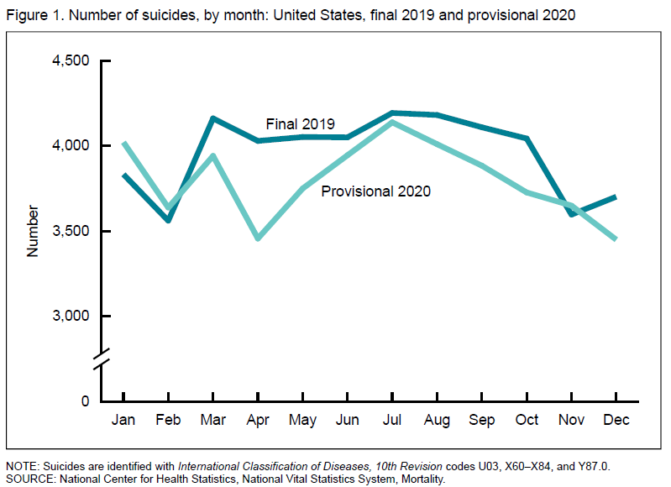
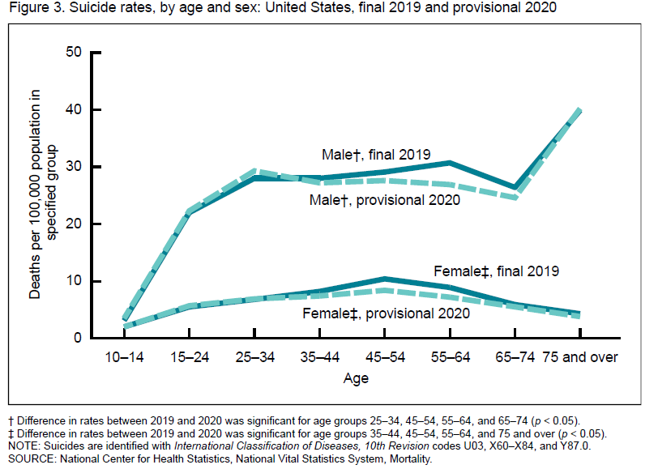
The provisional number of suicides in 2020 (45,855) was 3% lower than in 2019 (47,511). The provisional age-adjusted suicide rate was also 3% lower in 2020 (13.5 per 100,000) than in 2019 (13.9).

Slide 18

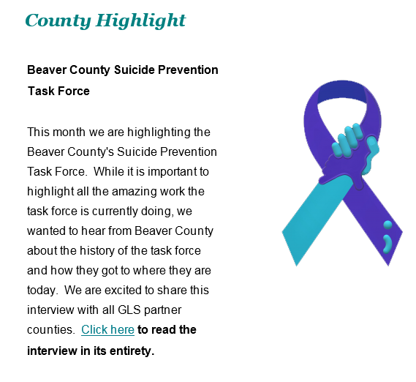

https://www.preventsuicidepa.org/wp-content/uploads/2021/11/Expansion-and-Transformation-of-the-National-Suicide-Prevention-Lifeline-Nov-2021.pdf
Check it out!!!!

Slide 19

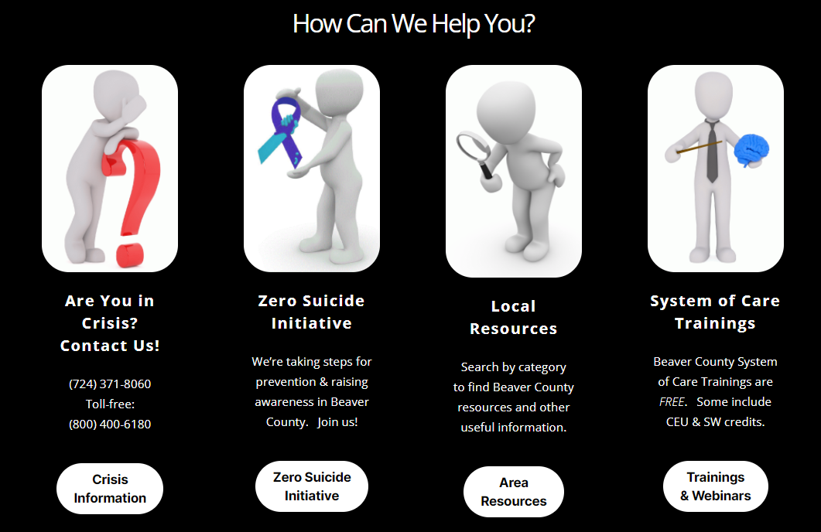
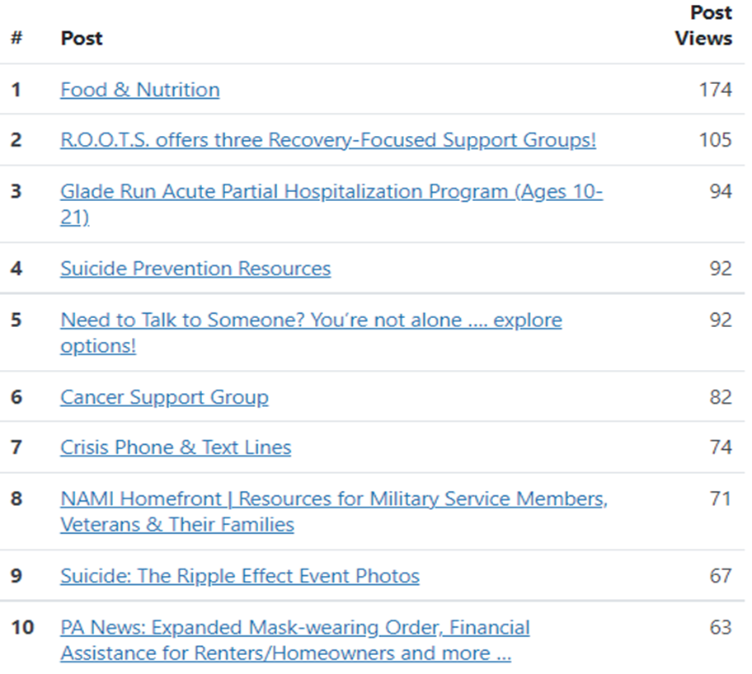
SOC Website NEW LOOK . . .
Please email comments, submissions and suggestions to SOCwebmaster@ahci.org

Slide 20


Trainings Available
QPR (Question, Persuade, and Refer)
Virtual or In-person
Youth QPR (Question, Persuade, and Refer)
Virtual or In-person
Mental Health First Aid
Youth Mental Health First Aid
Archived trainings:
BC SOC Youtube:
https://www.youtube.com/channel/UCDKZZQif0q0YIqfBgkEGc4Q
Beacon:
https://www.beaconhealthoptions.com/providers/beacon/important-tools/webinars/archive/
Prevent Suicide PA:
https://www.preventsuicidepa.org/trainings/all-trainings/
www.bc-systemofcare.org/training/

Slide 21

Next meeting
Date: January 28th at 1:30pm
Zoom link will be sent

Slide 22

Check out the website: http://www.bc-systemofcare.org/ Send updates to: SOCwebmaster@ahci.org SOC YouTube channel: https://www.youtube.com/watch?v=GY4rLQJRAcM&list=PL6lF8gWeCfKyHgu4A5RKl1SX7kH2BJrC-&index=2

Slide 23

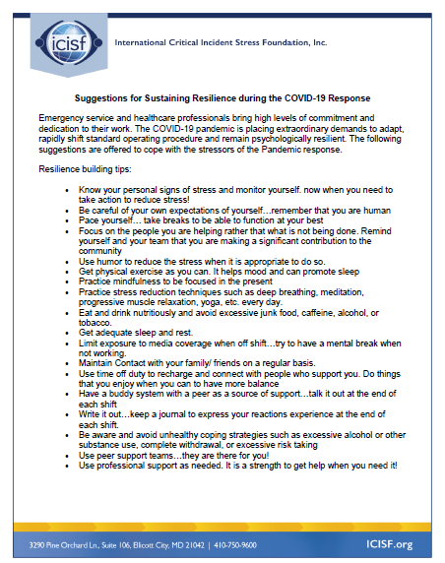



Slide 24

Resources
Please share the following resources with anyone who can benefit

Slide 25

Persevere PA Crisis Counseling Program (CCP) provides SAMHSA approved crisis counseling tele-health services, through the Center for Community Resources (CCR), and can be provided to people who need support related to the impacts of COVID-19. CCR provides the 24/7 Support and Referral Line that delivers the crisis counseling services.

Slide 26
Food Resources
https://www.agriculture.pa.gov/Food_Security/Pages/Resources.aspx
Mental Health Resources
https://www.pa.gov/guides/mental-health/
Unemployment Benefits
https://www.pa.gov/guides/unemployment-benefits/
COVID Testing
https://pema.maps.arcgis.com/apps/webappviewer/index.html?id=1a4c139769d646839e1549bcb6a668f1
COVID Guidance and Resources
https://www.pa.gov/guides/responding-to-covid-19/
Help for Homeowners / Landlords / Renters
https://www.consumerfinance.gov/coronavirus/mortgage-and-housing-assistance/renter-protections/find-help-with-rent-and-utilities/?utm_source=vanity&utm_medium=outreach&utm_campaign=renthelp
PA COVID Resources

Slide 27
Resources
The Mental Health Support Line
Developed on April 1st
Can be reached toll-free, 24/7 at 1-855-284-2494 from anywhere in PA.
Crisis Text Line
Text PA to 741-741
PA Get Help Now Helpline
Can be reached toll-free at 1-800-662-HELP (4357).
A live chat option is also available online or via text message at 717-216-0905
Warmline of Beaver County
Can be reached at 1-877-775-WARM (9276)
Hours of operation 6pm-9pm
UPMC Beaver County Crisis
Can be reached toll-free, 24/7 at 1-800-400-6180

Slide 28
PA Resources
Many other resources also remain available to Pennsylvanians in need of support, including:
National Suicide Prevention Lifeline: 1-800-273-TALK (8255)
Línea Nacional de Prevención del Suicidio: 1-888-628-9454
Crisis Text Line: Text “PA” to 741-741
Safe2Say: 1-844-723-2729 or www.safe2saypa.org
Veteran Crisis Line: 1-800-273-TALK (8255) (Press 1)
Disaster Distress Helpline: 1-800-985-5990
Get Help Now Hotline (for substance use disorders):
1-800-662-4357

Slide 29
COVID Resources
https://www.cdc.gov/coronavirus/2019-ncov/daily-life-coping/managing-stress-anxiety.html
https://mhanational.org/covid19
https://psychhub.com/covid-19

Slide 30

What can we do to help?
E-mail us:
Elisia Majors
emajors@bcbh.org
Stephanie Santoro
ssantoro@ahci.org
Bonnie Palmieri
bpalmieri@ahci.org

Slide 31



Thank you!! Stay Well!

