Slide 1

Zero Suicide Team Leaders
Beaver County
09/24/2021

Slide 2

Welcome!!!! ☺
Today’s meeting
A reminder of how this works
Sign-in
Type your name and organization into the chat box

Slide 3
Today’s Agenda
Minutes
Partner Updates
September- Suicide Awareness and Prevention Month
Marketing Committee & Community Outreach and Education Team Update
Trainings
Next Meeting
Resources

Slide 4
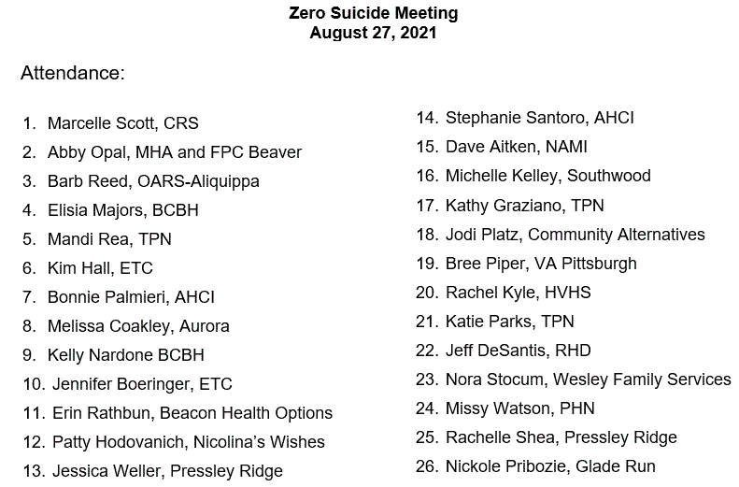


08.27.2021 PowerPoint
http://www.bc-systemofcare.org/zero-suicide/
Please use this PowerPoint as the minutes from last meeting

Slide 5
PARTNER UPDATES

Slide 6

NAMI BEAVER COUNTY WELCOMES YOU!
Come out and support a great event!
October 9th from 1-4 PM
Contact: Rick Mattia at (724)888-6877 or rmattia@namibeavercounty.com

Slide 7
The Consumer/Family Satisfaction Team of Beaver County (C/FST)
The C/FST of Beaver County is an independent agency.
The team believes that consumer satisfaction is very important.
The team cares about treatment options & your partnership in treatment plans. Simple questions are asked about the services that you are receiving.
The surveys are held in the STRICTEST CONFIDENCE & NO NAMES APPEAR ON ANY SURVEYS. The results are combined into a total report used ONLY to improve your services.

Slide 8
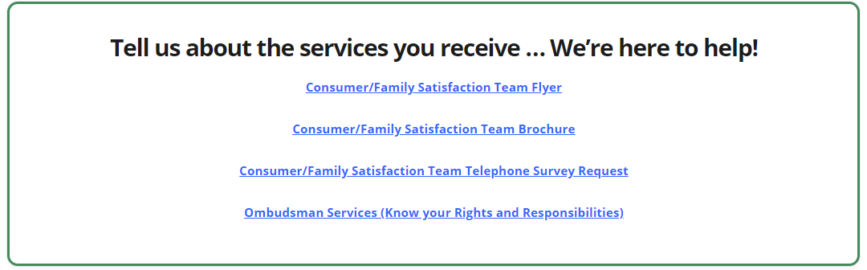
The Consumer/Family Satisfaction Team of Beaver County (C/FST)
Your Bridge to Quality Mental Health/Drug & Alcohol Care
www.bc-systemofcare.org/mental-health-resources/

Slide 9
American Foundation for Suicide Prevention
Out of the Darkness Walks in Lawrence County https://afsp.org/newcastle
All of our events can be found on our calendar: https://docs.google.com/document/d/105yD80-y2H_0JwvLDWJBxcIP17yYSo_AIJnByXTOirY/edit?usp=sharing

Slide 10

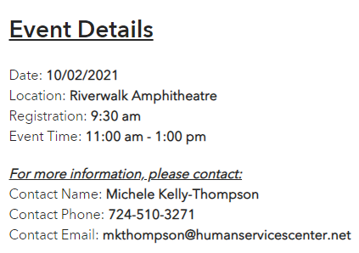
Beaver County Zero Suicide Initiative will be participating in Lawrence County’s Out of the Darkness Walk on October 2nd.

Slide 11
Mental Health Association
Our Ribbon Cutting for the NEW wall will be Wed. Sept. 29th from 2-3.
Drop in center calendar can be found at www.mhabc.org
In October special visits from:
Neighborhood Legal Services
BC Sheriff, Tony Guy, and K-9 Department

Slide 12

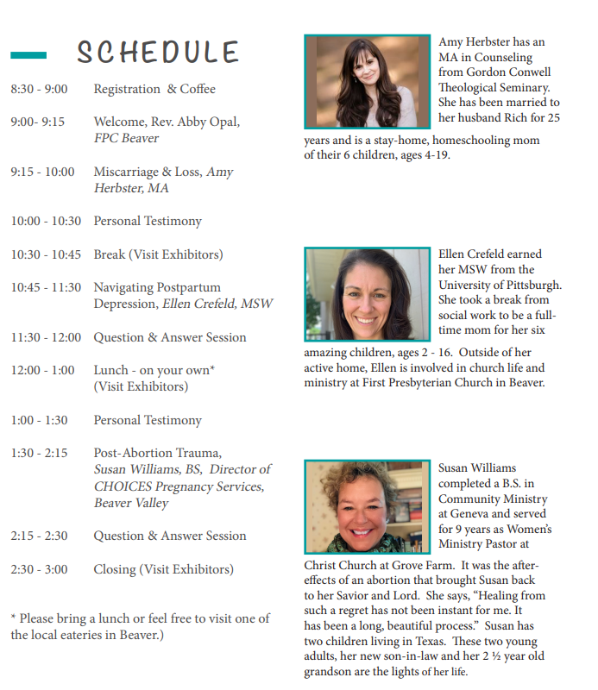
Let’s Talk About Mental Health

Slide 13
Other Updates

Slide 14

September- Suicide Awareness and Prevention Month
Send us your pictures!
We want to share!!

Slide 15


Beaver County Zero Suicide Third Annual Event
County and State Updates Provided
Unbreakable: A Story of Depression, Attempted Suicide and Miraculous Recovery, Jordan Burnham
Virtual Vendor Fair
Preventing Suicide 24/7/365: We Can ALL Take Action, Vicky Merski, LPC MS

Slide 16
Town Hall
79 people in attendance
Participants represented: MH providers, community members, first responders, family members, and individuals with lived experience
Feedback: overall positive
Survey results:
49 survey’s completed
Improved knowledge of county resources
Increased comfort level and willingness to help a person who is experiencing a mental health emergency

Slide 17



Marketing/Community Outreach and Education Team
POSTERS
AND
COASTERS
CAMPAIGN

Slide 18
Marketing/Community Outreach and Education Team
Partnered with the Beaver County D&A Coalition to develop “Posters and Coasters” Campaign
Goal:
Educate the community and provide resource materials to people who are not connected to our system of care
Distribute posters and coasters to the identified target areas
Area’s posters and coasters were delivered to:
Bars, restaurants, barber shops, hair salons, churches, feed stores, convenience stores, parks, police departments, etc..
Interested in obtaining some?
Contact: Elisia Majors emajors@bcbh.org or Marcy Scott mscott@crscares.org

Slide 19

Marketing/Community Outreach and Education Team
WE NEED YOU!!!!!!!!! Who wants to join the team???
Interested in joining the team?
Email: Marcy at mscott@crscares.org

Slide 20


Upcoming Trainings
NEXT
MONDAY!
Mental Health First Aid
Dates: 9/27
Additional information can be found on the website
Motivational Interviewing
Dates: 9/30 and 10/1
Additional information can be found on the website
www.bc-systemofcare.org/training/

Slide 21
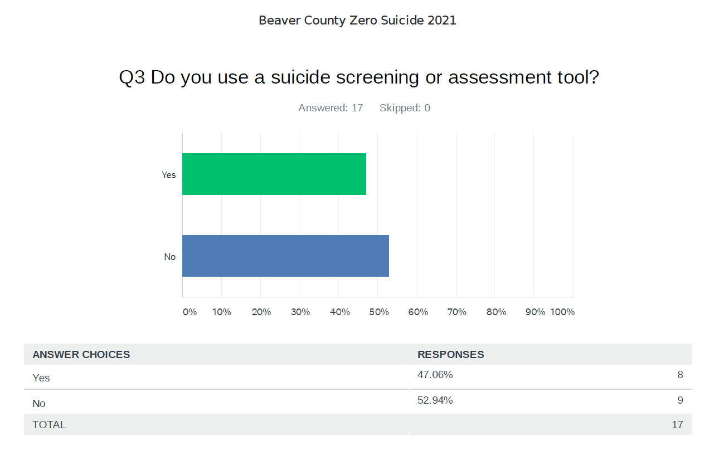
Zero Suicide Survey Results

Slide 22

Next meeting
Mark your calendars!
October 22nd at 1:30pm
Zoom link will be sent

Slide 23

Check out the website: http://www.bc-systemofcare.org/ Send updates to: SOCwebmaster@ahci.org SOC YouTube channel: https://www.youtube.com/watch?v=GY4rLQJRAcM&list=PL6lF8gWeCfKyHgu4A5RKl1SX7kH2BJrC-&index=2

Slide 24

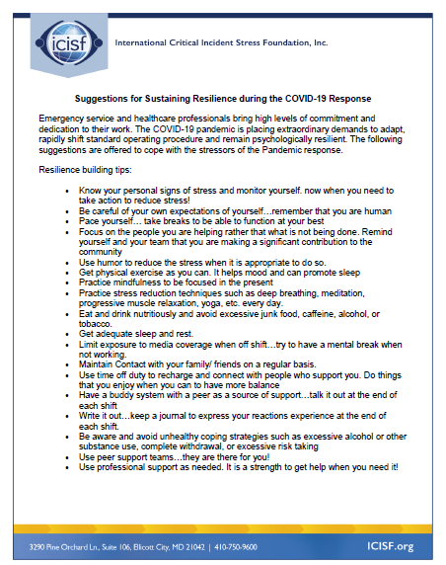



Slide 25

Resources
Please share the following resources with anyone who can benefit

Slide 26

Persevere PA Crisis Counseling Program (CCP) provides SAMHSA approved crisis counseling tele-health services, through the Center for Community Resources (CCR), and can be provided to people who need support related to the impacts of COVID-19. CCR provides the 24/7 Support and Referral Line that delivers the crisis counseling services.

Slide 27
Food Resources
https://www.agriculture.pa.gov/Food_Security/Pages/Resources.aspx
Mental Health Resources
https://www.pa.gov/guides/mental-health/
Unemployment Benefits
https://www.pa.gov/guides/unemployment-benefits/
COVID Testing
https://pema.maps.arcgis.com/apps/webappviewer/index.html?id=1a4c139769d646839e1549bcb6a668f1
COVID Guidance and Resources
https://www.pa.gov/guides/responding-to-covid-19/
Help for Homeowners / Landlords / Renters
https://www.consumerfinance.gov/coronavirus/mortgage-and-housing-assistance/renter-protections/find-help-with-rent-and-utilities/?utm_source=vanity&utm_medium=outreach&utm_campaign=renthelp
PA COVID Resources

Slide 28
Resources
The Mental Health Support Line
Developed on April 1st
Can be reached toll-free, 24/7 at 1-855-284-2494 from anywhere in PA.
Crisis Text Line
Text PA to 741-741
PA Get Help Now Helpline
Can be reached toll-free at 1-800-662-HELP (4357).
A live chat option is also available online or via text message at 717-216-0905
Warmline of Beaver County
Can be reached at 1-877-775-WARM (9276)
Hours of operation 6pm-9pm
UPMC Beaver County Crisis
Can be reached toll-free, 24/7 at 1-800-400-6180

Slide 29
PA Resources
Many other resources also remain available to Pennsylvanians in need of support, including:
National Suicide Prevention Lifeline: 1-800-273-TALK (8255)
Línea Nacional de Prevención del Suicidio: 1-888-628-9454
Crisis Text Line: Text “PA” to 741-741
Safe2Say: 1-844-723-2729 or www.safe2saypa.org
Veteran Crisis Line: 1-800-273-TALK (8255) (Press 1)
Disaster Distress Helpline: 1-800-985-5990
Get Help Now Hotline (for substance use disorders):
1-800-662-4357

Slide 30
COVID Resources
https://www.cdc.gov/coronavirus/2019-ncov/daily-life-coping/managing-stress-anxiety.html
https://mhanational.org/covid19
https://psychhub.com/covid-19

Slide 31

What can we do to help?
E-mail us:
Elisia Majors
emajors@bcbh.org
Stephanie Santoro
ssantoro@ahci.org
Bonnie Palmieri
bpalmieri@ahci.org

Slide 32



Thank you!! Stay Well!

