Slide 1

Zero Suicide Team Leaders
Beaver County
08/27/2021

Slide 2

Welcome!!!! ☺
Today’s meeting
A reminder of how this works
Sign-in
Type your name and organization into the chat box

Slide 3
Today’s Agenda
Minutes
Partner Updates
September- Suicide Awareness and Prevention Month
Marketing Committee & Community Outreach and Education Team Update
Trainings
Zero Suicide Annual Survey
Next Meeting
Resources

Slide 4
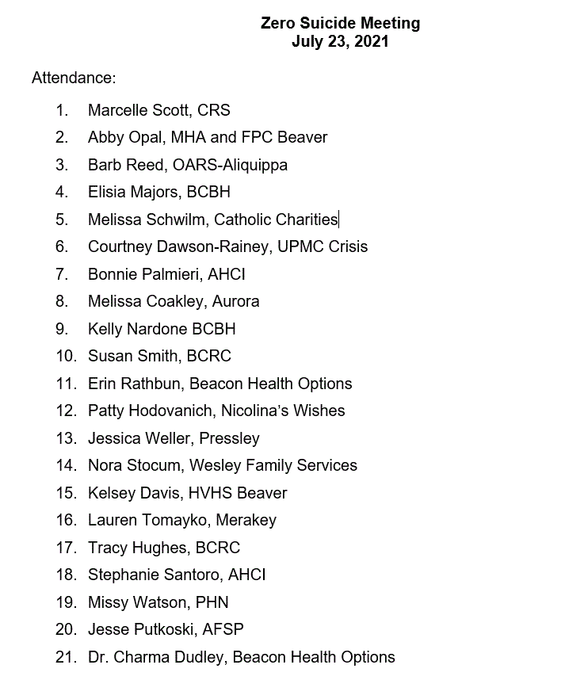


07.23.2021 PowerPoint
http://www.bc-systemofcare.org/zero-suicide/
Please use this PowerPoint as the minutes from last meeting

Slide 5
PARTNER UPDATES

Slide 6
American Foundation for Suicide Prevention
Out of the Darkness Walks in Pittsburgh and Lawrence County (https://afsp.org/pittsburgh and https://afsp.org/newcastle
All of our events can be found on our calendar: https://docs.google.com/document/d/105yD80-y2H_0JwvLDWJBxcIP17yYSo_AIJnByXTOirY/edit?usp=sharing

Slide 7

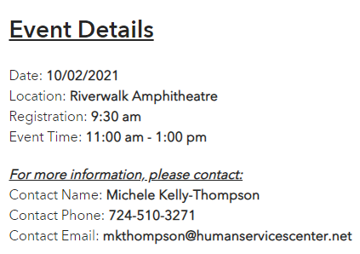
Beaver County Zero Suicide Initiative will be participating in Lawrence County’s Out of the Darkness Walk on October 2nd.

Slide 8

Suicide Prevention Guide
Make sure the check out the 2021 Suicide Prevention Guide
Includes:
Data
Tips of effective messaging
Resources for wellness, self care, BIPOC, etc..
Crisis resources
Social media messaging
Available for download:
www.bc-systemofcare.org/zero-suicide/

Slide 9


Beaver County Recovery Walk
Date: September 18th
Time: 9am-2pm
Location: Brady’s Run Walking Trail
Keep an eye out for more information!

Slide 10
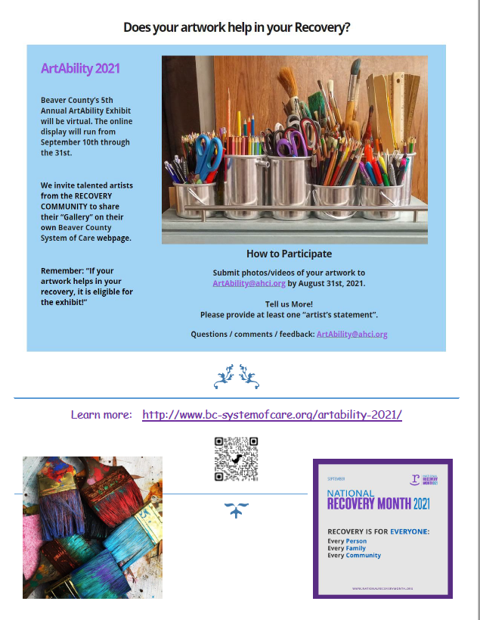
“ArtAbility 2021” Art Exhibit (Share the news!)
BC SOC holds this event in recognition of SAMHSA’s National Recovery Month, every September!
The ArtAbility Exhibit will be held virtually again this year. “No Strolling, Just Scrolling”
2021 is our 5th year and we are looking for talented artists from the Beaver County RECOVERY community. Each artist’s “gallery” will be featured on his/her own webpage on the SOC Website!
“If your artwork helps in your recovery, it is eligible for the exhibit!”
Questions / comments / feedback: ArtAbility@ahci.org
Submissions are welcome from now until Aug. 31st.

Slide 11


Suicide Prevention Toolkit Coming August 2021: Creating Hope Through Action
Make sure to sign up for their distribution list
https://preventsuicidepa.us1.list-manage.com/subscribe?u=e81391bf393c537408956a393&id=2b8881df16

Slide 12
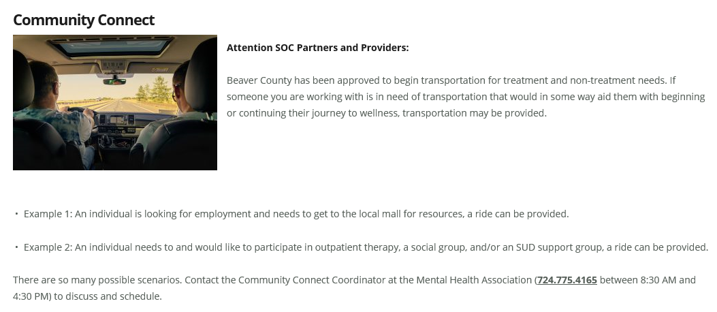


Slide 13
Other Updates

Slide 14

September- Suicide Awareness and Prevention Month
What do you have planned?
Send us your pictures!
We want to share!!

Slide 15


Beaver County Zero Suicide Third Annual Event
Registration Link:
https://us02web.zoom.us/webinar/register/WN_dKNmvVjoTZKjsEcDd-u2pw

Slide 16
Tentative Town Hall Agenda
Welcome and County Update
An Overview of Pennsylvania Statewide Initiatives, Dr. Perri Rosen
Unbreakable: A Story of Depression, Attempted Suicide and Miraculous Recovery, Jordan Burnham
Virtual Vendor Fair
Preventing Suicide 24/7/365: We Can ALL Take Action, Vicky Merski, LPC MS
Q&A & Closing Remarks

Slide 17

Virtual Vendor Video
28 slides and 4 videos representing 16 community partners Videos or power point slide
If you have not already done so, please send Stephanie Santoro (ssantoro@ahci.org) an electronic copy of your organizations brochure.
Town hall participants will receive a hyperlink following the event to a website where all of the community resources/brochures will be available.

Slide 18



Marketing/Community Outreach and Education Team
POSTERS
AND
COASTERS
CAMPAIGN

Slide 19
Marketing/Community Outreach and Education Team
Partnering with the Beaver County D&A Coalition to develop “Posters and Coasters” Campaign
Goals:
Get resource material out to people who are not connected to our system of care
Distribute posters and coasters to the identified target areas
WE NEED YOU!!!!!!!!! Who wants to join the team???
Interested in joining the team?
Email: Marcy at mscott@crscares.org

Slide 20

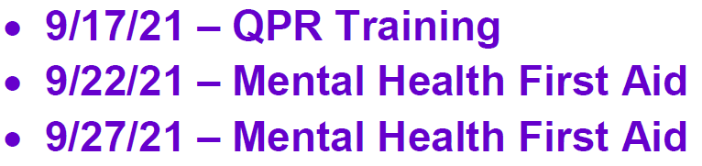

Upcoming Trainings
www.bc-systemofcare.org/training/

Slide 21
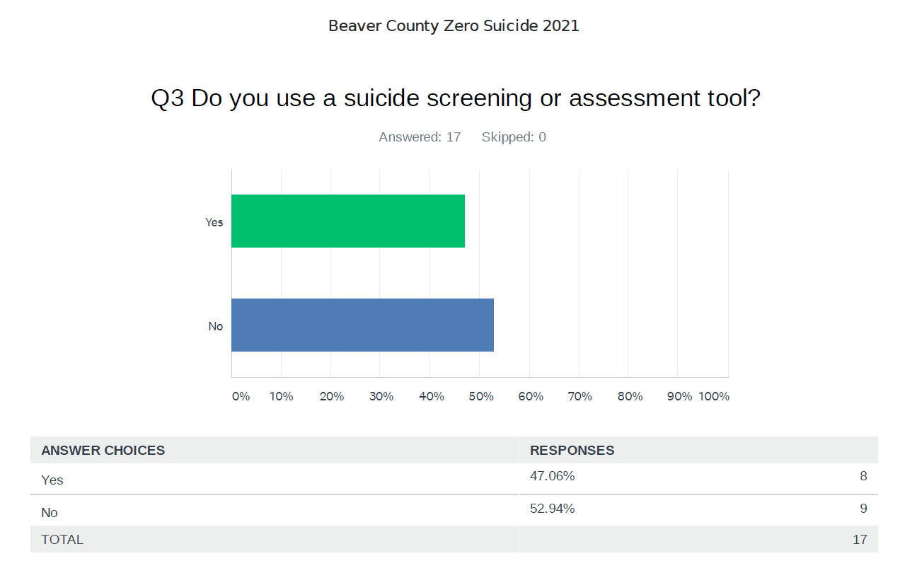
Zero Suicide Survey Results

Slide 22

Next meeting
Mark your calendars!
September 24th at 1:30pm
Zoom link will be sent

Slide 23

Check out the website: http://www.bc-systemofcare.org/ Send updates to: SOCwebmaster@ahci.org SOC YouTube channel: https://www.youtube.com/watch?v=GY4rLQJRAcM&list=PL6lF8gWeCfKyHgu4A5RKl1SX7kH2BJrC-&index=2

Slide 24

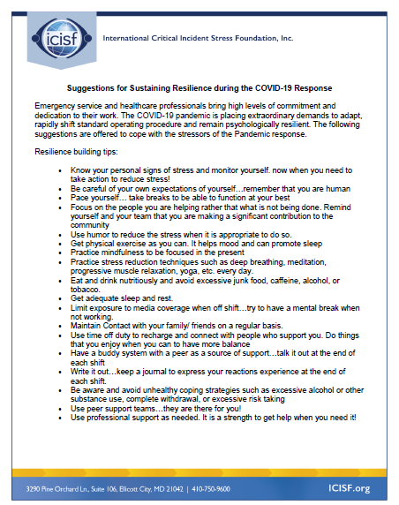



Slide 25

Resources
Please share the following resources with anyone who can benefit

Slide 26

Persevere PA Crisis Counseling Program (CCP) provides SAMHSA approved crisis counseling tele-health services, through the Center for Community Resources (CCR), and can be provided to people who need support related to the impacts of COVID-19. CCR provides the 24/7 Support and Referral Line that delivers the crisis counseling services.

Slide 27
Food Resources
https://www.agriculture.pa.gov/Food_Security/Pages/Resources.aspx
Mental Health Resources
https://www.pa.gov/guides/mental-health/
Unemployment Benefits
https://www.pa.gov/guides/unemployment-benefits/
COVID Testing
https://pema.maps.arcgis.com/apps/webappviewer/index.html?id=1a4c139769d646839e1549bcb6a668f1
COVID Guidance and Resources
https://www.pa.gov/guides/responding-to-covid-19/
Help for Homeowners / Landlords / Renters
https://www.consumerfinance.gov/coronavirus/mortgage-and-housing-assistance/renter-protections/find-help-with-rent-and-utilities/?utm_source=vanity&utm_medium=outreach&utm_campaign=renthelp
PA COVID Resources

Slide 28
Resources
The Mental Health Support Line
Developed on April 1st
Can be reached toll-free, 24/7 at 1-855-284-2494 from anywhere in PA.
Crisis Text Line
Text PA to 741-741
PA Get Help Now Helpline
Can be reached toll-free at 1-800-662-HELP (4357).
A live chat option is also available online or via text message at 717-216-0905
Warmline of Beaver County
Can be reached at 1-877-775-WARM (9276)
Hours of operation 6pm-9pm
UPMC Beaver County Crisis
Can be reached toll-free, 24/7 at 1-800-400-6180

Slide 29
PA Resources
Many other resources also remain available to Pennsylvanians in need of support, including:
National Suicide Prevention Lifeline: 1-800-273-TALK (8255)
Línea Nacional de Prevención del Suicidio: 1-888-628-9454
Crisis Text Line: Text “PA” to 741-741
Safe2Say: 1-844-723-2729 or www.safe2saypa.org
Veteran Crisis Line: 1-800-273-TALK (8255) (Press 1)
Disaster Distress Helpline: 1-800-985-5990
Get Help Now Hotline (for substance use disorders):
1-800-662-4357

Slide 30
COVID Resources
https://www.cdc.gov/coronavirus/2019-ncov/daily-life-coping/managing-stress-anxiety.html
https://mhanational.org/covid19
https://psychhub.com/covid-19

Slide 31

What can we do to help?
E-mail us:
Elisia Majors
emajors@bcbh.org
Stephanie Santoro
ssantoro@ahci.org
Bonnie Palmieri
bpalmieri@ahci.org

Slide 32



Thank you!! Stay Well!

