Slide 1

Zero Suicide Team Leaders
Beaver County
10/22/2021

Slide 2

Welcome!!!! ☺
Today’s meeting
A reminder of how this works
Sign-in
Type your name and organization into the chat box

Slide 3
Today’s Agenda
Minutes
Partner Updates
September- Suicide Awareness and Prevention Month
Marketing Committee & Community Outreach and Education Team Update
Trainings
Next Meeting
Resources

Slide 4
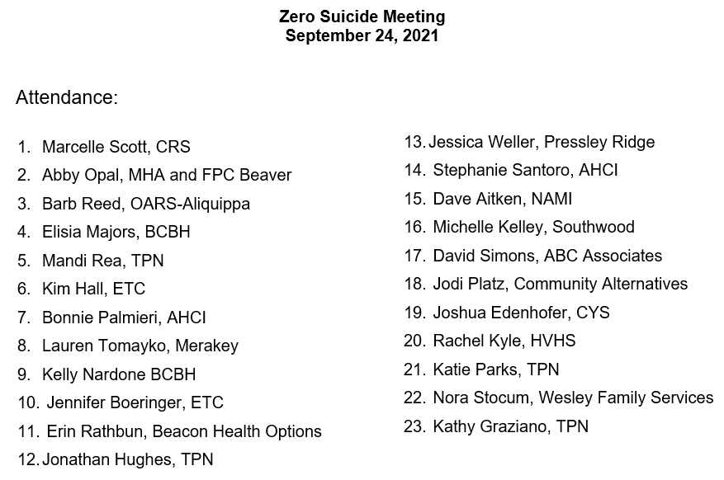


08.27.2021 PowerPoint
http://www.bc-systemofcare.org/zero-suicide/
Please use this PowerPoint as the minutes from last meeting

Slide 5
PARTNER UPDATES

Slide 6
Mental Health Association
Our annual Christmas party will be held Wed. Dec. 8th.
Flyer include in today’s hanouts.
REGISTRATION IS REQUIRED due to limits on capacity/attendance due to Covid.
There will be limited bus service.
Please call 724-775-4165 to register. People will get to choose a gift to receive at the party when they register before Nov. 15th.
Our Nov. Drop-in Center Calendar also included in today’s meeting handouts.
A couple of highlights include: the BC Humane Society is coming to visit and we are having an Understanding Drug and Alcohol Addiction talk by Keystone Wellness.
We are not having our large annual Thanksgiving Dinner this year. However, we will have turkey and fixings in for our drop in center members the 3 days prior to the holiday.
Community Connect stats: Having just started in August we had 16 rides and served 8 people. In September we grew to provide 48 rides; this included 10 new people and 4 repeat from August.

Slide 7
Other Updates

Slide 8




Marketing/Community Outreach and Education Team
POSTERS
AND
COASTERS
CAMPAIGN
Check out the video!!

Slide 9
Marketing/Community Outreach and Education Team
Partnered with the Beaver County D&A Coalition to develop “Posters and Coasters” Campaign
Goal:
Educate the community and provide resource materials to people who are not connected to our system of care
Distribute posters and coasters to the identified target areas
Area’s posters and coasters were delivered to:
Bars, restaurants, barber shops, hair salons, churches, feed stores, convenience stores, parks, police departments, etc..
Interested in obtaining some?
Contact: Elisia Majors emajors@bcbh.org or Marcy Scott mscott@crscares.org

Slide 10

To register: https://us02web.zoom.us/meeting/register/tZIkde6qpjosHdQftTSujrvam1z59rf716CQ

Slide 11

GLS Youth Suicide Prevention Grant Team
To view more detailed information and to register, please click the flyer or visit, https://www.preventsuicidepa.org/webinars/. Please feel free to share this with anyone who may be interested.

Slide 12

Anxiety and Stress Management Support Group
For girls ages 14-18.
To view more detailed information and to register, please click the flyer or visit http://www.bc-systemofcare.org/anxiety-stress-management-support-group/. Please feel free to share this with anyone who may be interested.

Slide 13
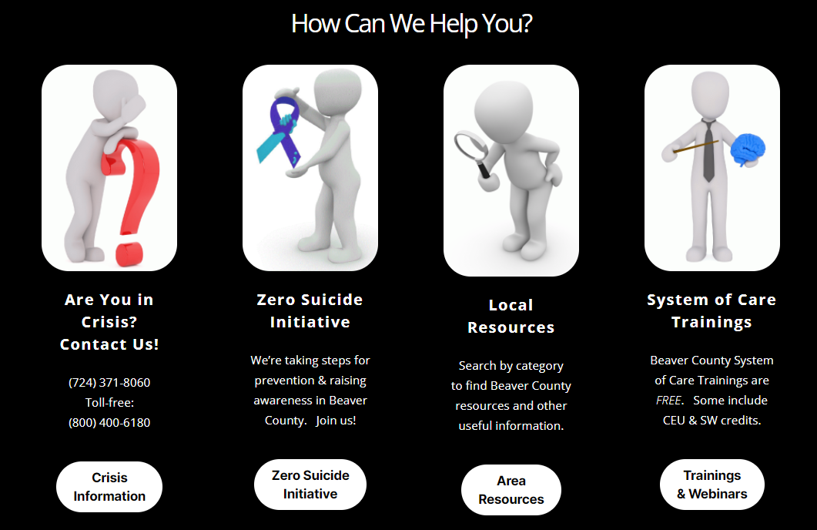
SOC Website News!
New Look!
New Heading
What is the SOC?
Site Navigation
Youth Ambassador Program
Sharing a Shortcut!

Slide 14



Slide 15

About “them Stillers” . . .
Tomorrow, 10/23/2021
Free Groceries & Supplies!
At CCBC from 10:00am – 1:30pm until supplies run out.

Slide 16


Trainings Available
QPR (Question, Persuade, and Refer)
Virtual or In-person
Youth QPR (Question, Persuade, and Refer)
Virtual or In-person
Mental Health First Aid
Youth Mental Health First Aid
Archived trainings:
BC SOC Youtube:
https://www.youtube.com/channel/UCDKZZQif0q0YIqfBgkEGc4Q
Beacon:
https://www.beaconhealthoptions.com/providers/beacon/important-tools/webinars/archive/
Prevent Suicide PA:
https://www.preventsuicidepa.org/trainings/all-trainings/
www.bc-systemofcare.org/training/

Slide 17

Next meeting
Date: Let’s discuss
Zoom link will be sent

Slide 18

Check out the website: http://www.bc-systemofcare.org/ Send updates to: SOCwebmaster@ahci.org SOC YouTube channel: https://www.youtube.com/watch?v=GY4rLQJRAcM&list=PL6lF8gWeCfKyHgu4A5RKl1SX7kH2BJrC-&index=2

Slide 19

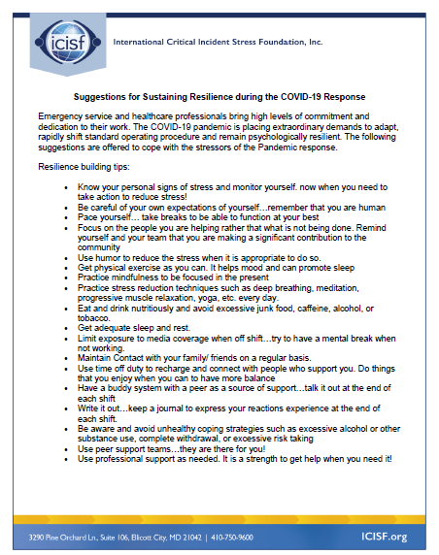



Slide 20

Resources
Please share the following resources with anyone who can benefit

Slide 21

Persevere PA Crisis Counseling Program (CCP) provides SAMHSA approved crisis counseling tele-health services, through the Center for Community Resources (CCR), and can be provided to people who need support related to the impacts of COVID-19. CCR provides the 24/7 Support and Referral Line that delivers the crisis counseling services.

Slide 22
Food Resources
https://www.agriculture.pa.gov/Food_Security/Pages/Resources.aspx
Mental Health Resources
https://www.pa.gov/guides/mental-health/
Unemployment Benefits
https://www.pa.gov/guides/unemployment-benefits/
COVID Testing
https://pema.maps.arcgis.com/apps/webappviewer/index.html?id=1a4c139769d646839e1549bcb6a668f1
COVID Guidance and Resources
https://www.pa.gov/guides/responding-to-covid-19/
Help for Homeowners / Landlords / Renters
https://www.consumerfinance.gov/coronavirus/mortgage-and-housing-assistance/renter-protections/find-help-with-rent-and-utilities/?utm_source=vanity&utm_medium=outreach&utm_campaign=renthelp
PA COVID Resources

Slide 23
Resources
The Mental Health Support Line
Developed on April 1st
Can be reached toll-free, 24/7 at 1-855-284-2494 from anywhere in PA.
Crisis Text Line
Text PA to 741-741
PA Get Help Now Helpline
Can be reached toll-free at 1-800-662-HELP (4357).
A live chat option is also available online or via text message at 717-216-0905
Warmline of Beaver County
Can be reached at 1-877-775-WARM (9276)
Hours of operation 6pm-9pm
UPMC Beaver County Crisis
Can be reached toll-free, 24/7 at 1-800-400-6180

Slide 24
PA Resources
Many other resources also remain available to Pennsylvanians in need of support, including:
National Suicide Prevention Lifeline: 1-800-273-TALK (8255)
Línea Nacional de Prevención del Suicidio: 1-888-628-9454
Crisis Text Line: Text “PA” to 741-741
Safe2Say: 1-844-723-2729 or www.safe2saypa.org
Veteran Crisis Line: 1-800-273-TALK (8255) (Press 1)
Disaster Distress Helpline: 1-800-985-5990
Get Help Now Hotline (for substance use disorders):
1-800-662-4357

Slide 25
COVID Resources
https://www.cdc.gov/coronavirus/2019-ncov/daily-life-coping/managing-stress-anxiety.html
https://mhanational.org/covid19
https://psychhub.com/covid-19

Slide 26

What can we do to help?
E-mail us:
Elisia Majors
emajors@bcbh.org
Stephanie Santoro
ssantoro@ahci.org
Bonnie Palmieri
bpalmieri@ahci.org

Slide 27



Thank you!! Stay Well!

