Slide 1

Zero Suicide Team Leaders
Beaver County
07/23/2021

Slide 2

Welcome!!!! ☺
Today’s meeting
  A reminder of how this works
Sign-in
  Type your name and organization into the chat box

Slide 3
Today’s Agenda
Minutes
Dr. Charma Dudley
Partner Updates
Zero Suicide Annual Survey
Marketing Committee & Community Outreach and Education Team Update
September- Suicide Awareness and Prevention Month
Trainings
Next Meeting
Resources

Slide 4
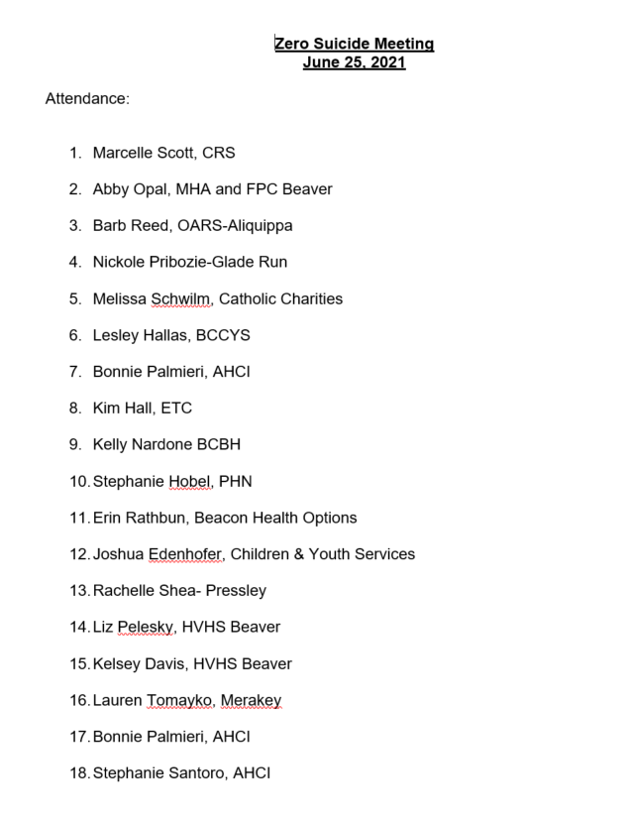


06.25.2021 PowerPoint
http://www.bc-systemofcare.org/zero-suicide/
Please use this PowerPoint as the minutes from last meeting

Slide 5
Welcome Dr. Dudley

Slide 6
PARTNER UPDATES

Slide 7
American Foundation for Suicide Prevention
Out of the Darkness Walks in Pittsburgh and Lawrence County (https://afsp.org/pittsburgh and https://afsp.org/newcastle
All of our events can be found on our calendar: https://docs.google.com/document/d/105yD80-y2H_0JwvLDWJBxcIP17yYSo_AIJnByXTOirY/edit?usp=sharing
New presentation called- It’s Real: Teens and Mental Health.
  It is intended for ages 14 and older and goes over general mental health information and resources for youth, information on how to notice signs of deterioration in mental health, tips and strategies on how to start a caring conversation about mental health, and information on how to engage in methods of self-care.

Slide 8


Suicide Prevention Toolkit Coming August 2021: Creating Hope Through Action
Make sure to sign up for their distribution list
https://preventsuicidepa.us1.list-manage.com/subscribe?u=e81391bf393c537408956a393&id=2b8881df16

Slide 9
Mental Health Association
Our Phoenix Drop-in Center will no longer require reservations beginning August 1. You may drop-in any time between 10 AM and 2 PM, Tuesday through Friday. Our August schedule is attached.
The MHA Annual Purse Party will be held this September. More information will be coming soon.
Let’s Talk About Mental Health:
Our Fall Seminar will be held at FPC Beaver on Saturday, Sept. 25 from 9 AM – 3 PM and will be on Pregnancy Loss and Mental Health. Stay tuned for more info.

Slide 10
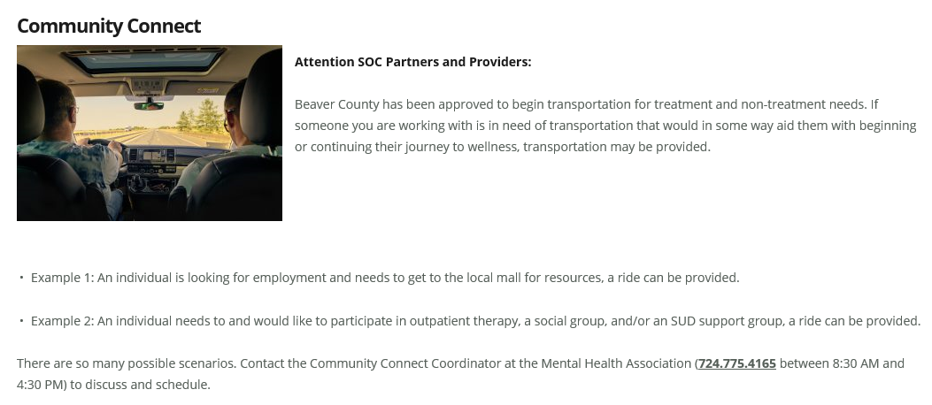


Slide 11
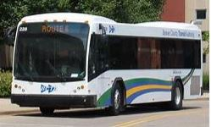
Website News:
New!
Transportation Webpage
www.bc-systemofcare.org
  ☞ Resources  Transportation
Community Connect Referral Form
BCTA Programs
Faith in Action
Taxi
Uber
Lift
Free Training!
Youth Mental Health First Aid
BCBH
1040 8th Ave. 2nd Fl.
Beaver Falls, PA 15010
July 26, 2021
8:30am – 4:30pm
Registration is Open!
www.bc-systemofcare.org
  ☞ Resources  Training

Slide 12
Other Updates

Slide 13
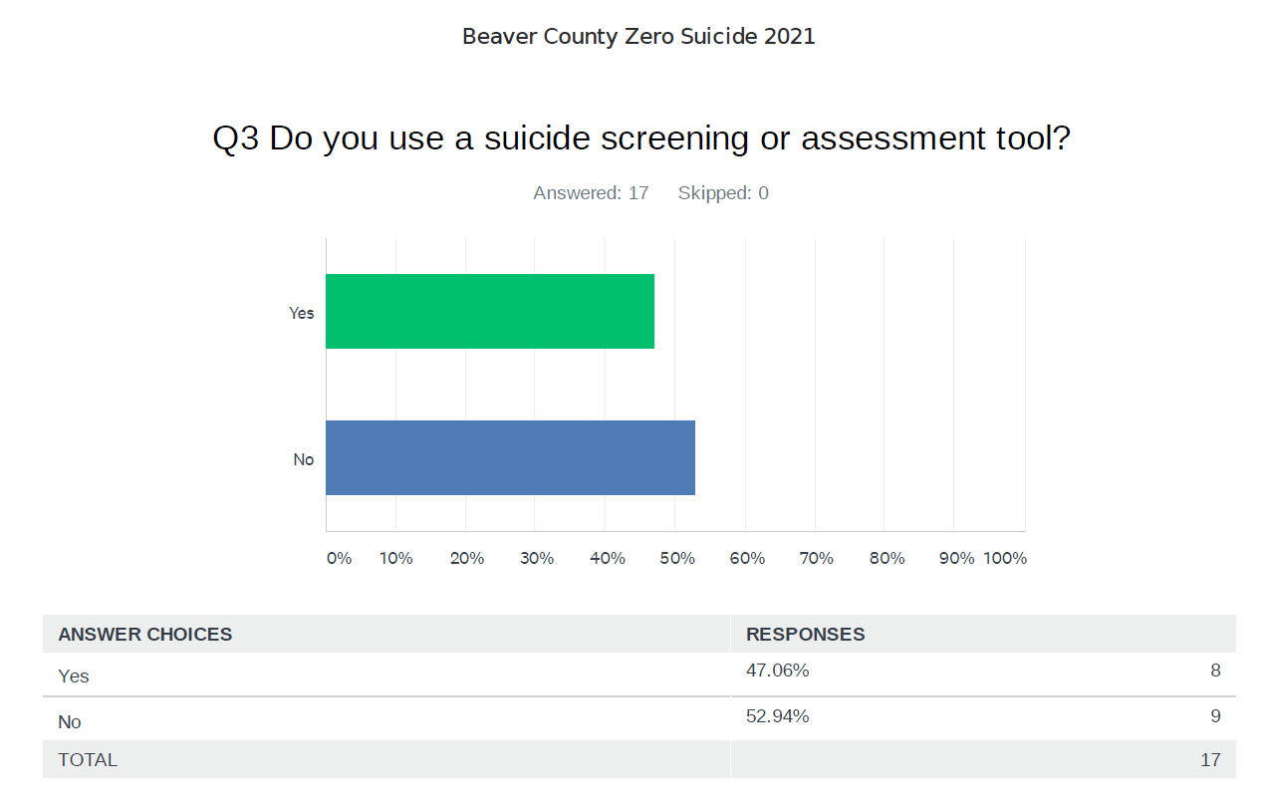
Zero Suicide Survey Results

Slide 14
Marketing/Community Outreach and Education Team
Partnering with the Beaver County D&A Coalition to develop “Posters and Coasters” Campaign
Met on 7/15 and 7/21
  Goals:
    Get resource material out to people who are not connected to our system of care
    Distribute posters and coasters to the identified target areas
WE NEED YOU!!!!!!!!! Who wants to join the team???
Interested in joining the team?
  Email: Marcy at mscott@crscares.org

Slide 15

September- Suicide Awareness and Prevention Month
Update:
  Activities:
    Town Hall
      Exploring virtual and hybrid options
        Speakers
    Other suggestions?
What is your agency going to do?

Slide 16
“ArtAbility 2021” Art Exhibit (Share the news!)
BC SOC holds this event in recognition of SAMHSA’s National Recovery Month, every September!
The ArtAbility Exhibit occurred virtually last year, due to COVID.
We might do the same or a “hybrid” version this year.
“No Strolling, Just Scrolling”
2021 is our 5th year and we are looking for talented artists from the Beaver County RECOVERY community. Each artist’s “gallery” will be featured on his/her own webpage on the SOC Website!
“If your artwork helps in your recovery, it is eligible for the exhibit!”
Questions / comments / feedback: ArtAbility@ahci.org
Submissions are welcome from now until August 31st.

Slide 17

Check out the website: http://www.bc-systemofcare.org/
Send updates to: SOCwebmaster@ahci.org
SOC YouTube channel: https://www.youtube.com/watch?v=GY4rLQJRAcM&list=PL6lF8gWeCfKyHgu4A5RKl1SX7kH2BJrC-&index=2

Slide 18

Next meeting
Mark your calendars!
August 27th at 1:30pm
Zoom link will be sent

Slide 19

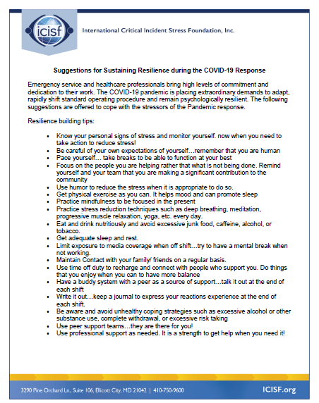



Slide 20

Resources
Please share the following resources with anyone who can benefit

Slide 21

Persevere PA Crisis Counseling Program (CCP) provides SAMHSA approved crisis counseling tele-health services, through the Center for Community Resources (CCR), and can be provided to people who need support related to the impacts of COVID-19. CCR provides the 24/7 Support and Referral Line that delivers the crisis counseling services.

Slide 22
Food Resources
https://www.agriculture.pa.gov/Food_Security/Pages/Resources.aspx
Mental Health Resources
https://www.pa.gov/guides/mental-health/
Unemployment Benefits
https://www.pa.gov/guides/unemployment-benefits/
COVID Testing
https://pema.maps.arcgis.com/apps/webappviewer/index.html?id=1a4c139769d646839e1549bcb6a668f1
COVID Guidance and Resources
https://www.pa.gov/guides/responding-to-covid-19/
PA COVID Resources

Slide 23
Resources
The Mental Health Support Line
Developed on April 1st
Can be reached toll-free, 24/7 at 1-855-284-2494 from anywhere in PA.
Crisis Text Line
Text PA to 741-741
PA Get Help Now Helpline
Can be reached toll-free at 1-800-662-HELP (4357).
A live chat option is also available online or via text message at 717-216-0905
Warmline of Beaver County
Can be reached at 1-877-775-WARM (9276)
Hours of operation 6pm-9pm
UPMC Beaver County Crisis
Can be reached toll-free, 24/7 at 1-800-400-6180

Slide 24
PA Resources
Many other resources also remain available to Pennsylvanians in need of support, including:
  National Suicide Prevention Lifeline: 1-800-273-TALK (8255)
  Línea Nacional de Prevención del Suicidio: 1-888-628-9454
  Crisis Text Line: Text “PA” to 741-741
  Safe2Say: 1-844-723-2729 or www.safe2saypa.org
  Veteran Crisis Line: 1-800-273-TALK (8255) (Press 1)
  Disaster Distress Helpline: 1-800-985-5990
  Get Help Now Hotline (for substance use disorders):
  1-800-662-4357

Slide 25
COVID Resources
https://www.cdc.gov/coronavirus/2019-ncov/daily-life-coping/managing-stress-anxiety.html
https://mhanational.org/covid19
https://psychhub.com/covid-19

Slide 26

What can we do to help?
E-mail us:
Elisia Majors
emajors@bcbh.org
Stephanie Santoro
ssantoro@ahci.org
Bonnie Palmieri
bpalmieri@ahci.org

Slide 27



Thank you!!
Stay Well!

