Slide 1

Zero Suicide Team Leaders
Beaver County
06/25/2021

Slide 2

Welcome!!!! ☺
Today’s meeting
A reminder of how this works
Sign-in
Type your name and organization into the chat box

Slide 3
Today’s Agenda
Minutes
Partner Updates
Marketing Committee
Community Outreach and Education Team
Mental Health Awareness Month Summary
September- Suicide Awareness and Prevention Month
Trainings
Next Meeting
Resources

Slide 4


 | Zero Suicide Team Meeting | 05/21/2021
 | Name | Partner agency
1 | Jennifer Boeringer | ETC
2 | Elisia Majors | BCBH
3 | Barbara Reed | OARS
4 | Dave Aiken | NAMI
5 | Abby Opal | MHA
6 | Michele Kelley | Southwood
7 | Traci Hughes | BCRC
8 | Johnathan Hughes | TPN
9 | Jodi Platz | Community Alternative
10 | Stephanie Hobel | PHN
11 | Stephanie Santoro | AHCI
12 | Kim Hall | ETC
13 | Amy Solman | Geneva College
14 | Angela Masciantonio | TPN
15 | Bonnie Palmieri | AHCI
16 | Erin Rathbun | Beacon Health Options
17 | Jessica Weller | Pressley Ridge
18 | Kathy Graziano | TPN
19 | Katie Parks | TPN
20 | Kelly Nardone | BCBH
21 | Mandi Rea | TPN
22 | Melissa Coakley | Aurora
23 | Missy Watson | PHN
24 | Marcy Scott | CRS
25 | Rachel Kyle | HVHS
05.21.2021 PowerPoint
http://www.bc-systemofcare.org/zero-suicide/
Please use this PowerPoint as the minutes from last meeting

Slide 5
PARTNER UPDATES

Slide 6
Mental Health Association
About 95% of the MHA staff have gone through QPR training.
The new Phoenix Center calendar for July was included with today’s meeting handouts. We are filling up more than 2 weeks in advance, so please make reservations early.

Slide 7
Other Updates

Slide 8

Did you take the annual Zero Suicide Survey?
http://www.bc-systemofcare.org/do-you-have-a-couple-minutes-to-complete-a-quick-survey/

Slide 9
Public Hearing and Human Service Plan Annual Survey
Public Hearing
Scheduled for 6/30 from 1-3pm
Register: https://us02web.zoom.us/meeting/register/tZUqf-6hrjsrHtBcAeMjPGQj93ywGFKjU0sc?mc_cid=0a2ff0988f&mc_eid=7eb82693e7
Did you take the survey? Your feedback is important!
https://www.surveymonkey.com/r/2021HSBG

Slide 10
Marketing/Community Outreach and Education Team
Partnering with the Beaver County D&A Coalition to develop “Posters and Coasters” Campaign
Goals:
Get resource material out to people who are not connected to our system of care
Educate natural listeners (bartenders, barbers, stylist) on the warning signs and available resources
WE NEED YOU!!!!!!!!! Who wants to join the team???
Interested in joining the team?
Email: Marcy at mscott@crscares.org

Slide 11

May- Mental Health Awareness Month
Accomplishments:

Slide 12

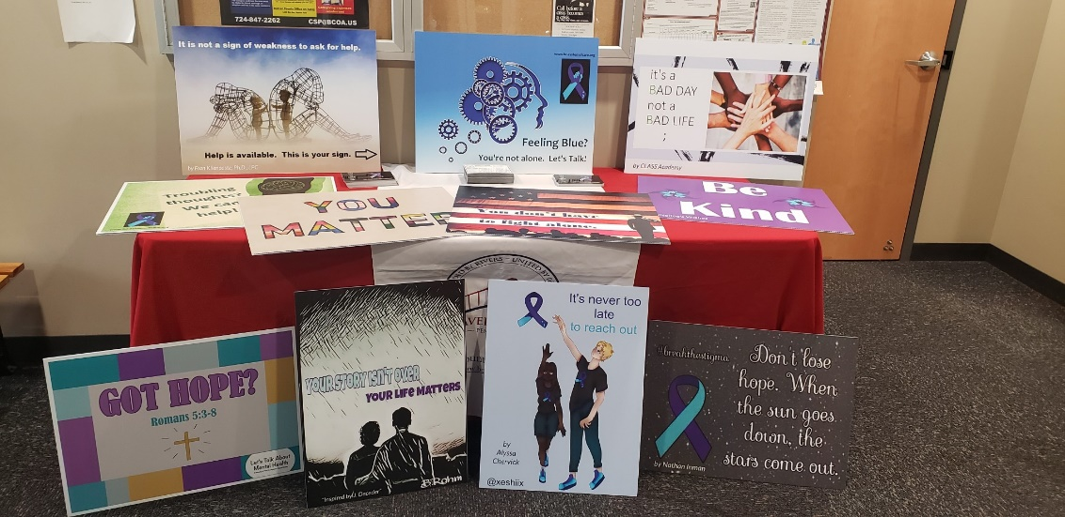
SUCCESS!
Over 800 signs were distributed throughout Beaver County.

Slide 13


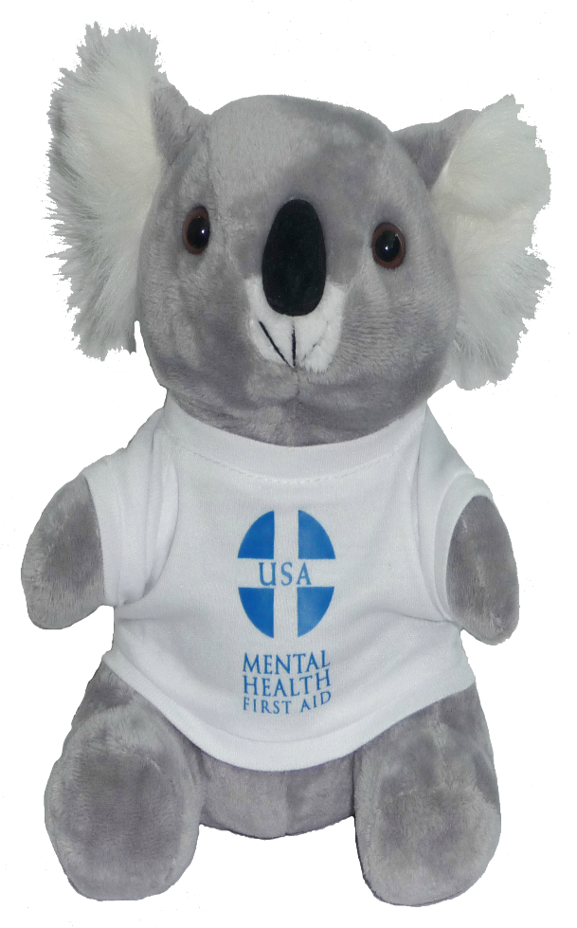

MAY TRAININGS
Virtual Trainings
5/17/21 Safety First: Basic Suicide Prevention Training
5/19/21 Screening of – Suicide: The Ripple Effect
5/21/21 QPR Training
In-Person Training
5/20/21 Mental Health First Aid
Reminder:
Check out the archived webinars!
Zero Suicide trainings
System of Care trainings
Co-Occurring Disorder Trainings

Slide 14

Annual Wellness Walk and Ice Cream Social
Huge Success
121 of people registered
Hank’s FREE ice cream coupons emailed to those who registered
SHOUT OUT and THANKS to Hanks and everyone else who helped make it a successful event!

Slide 15

September- Suicide Awareness and Prevention Month
What are we going to do as a taskforce?
Activities
Town Hall
Topics
Speakers
Other suggestions?
What is your agency going to do?

Slide 16
“ArtAbility 2021” Art Exhibit (Share the news!)
BC SOC holds this event in recognition of SAMHSA’s National Recovery Month, every September!
The ArtAbility Exhibit occurred virtually last year, due to COVID. We might do the same or a “hybrid” version this year.
“No Strolling, Just Scrolling”
2021 is our 5th year and we are looking for talented artists from the Beaver County RECOVERY community. Each artist’s “gallery” will be featured on his/her own webpage on the SOC Website!
“If your artwork helps in your recovery, it is eligible for the exhibit!”
Questions / comments / feedback: ArtAbility@ahci.org
Submissions are welcome from now until August 31st.

Slide 17

Check out the website: http://www.bc-systemofcare.org/ Send updates to: SOCwebmaster@ahci.org SOC YouTube channel: https://www.youtube.com/watch?v=GY4rLQJRAcM&list=PL6lF8gWeCfKyHgu4A5RKl1SX7kH2BJrC-&index=2

Slide 18

Next meeting
July 23rd at 1:30pm
Zoom link will be sent

Slide 19

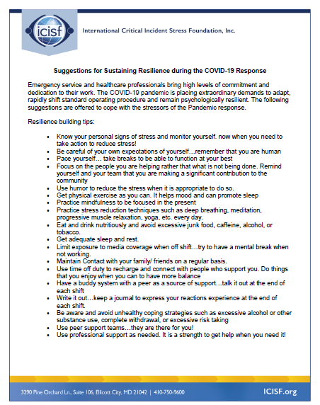



Slide 20

Resources
Please share the following resources with anyone who can benefit

Slide 21

Persevere PA Crisis Counseling Program (CCP) provides SAMHSA approved crisis counseling tele-health services, through the Center for Community Resources (CCR), and can be provided to people who need support related to the impacts of COVID-19. CCR provides the 24/7 Support and Referral Line that delivers the crisis counseling services.

Slide 22
Food Resources
https://www.agriculture.pa.gov/Food_Security/Pages/Resources.aspx
Mental Health Resources
https://www.pa.gov/guides/mental-health/
Unemployment Benefits
https://www.pa.gov/guides/unemployment-benefits/
COVID Testing
https://pema.maps.arcgis.com/apps/webappviewer/index.html?id=1a4c139769d646839e1549bcb6a668f1
COVID Guidance and Resources
https://www.pa.gov/guides/responding-to-covid-19/
PA COVID Resources

Slide 23
Resources
The Mental Health Support Line
Developed on April 1st
Can be reached toll-free, 24/7 at 1-855-284-2494 from anywhere in PA.
Crisis Text Line
Text PA to 741-741
PA Get Help Now Helpline
Can be reached toll-free at 1-800-662-HELP (4357).
A live chat option is also available online or via text message at 717-216-0905
Warmline of Beaver County
Can be reached at 1-877-775-WARM (9276)
Hours of operation 6pm-9pm
UPMC Beaver County Crisis
Can be reached toll-free, 24/7 at 1-800-400-6180

Slide 24
PA Resources
Many other resources also remain available to Pennsylvanians in need of support, including:
National Suicide Prevention Lifeline: 1-800-273-TALK (8255)
Línea Nacional de Prevención del Suicidio: 1-888-628-9454
Crisis Text Line: Text “PA” to 741-741
Safe2Say: 1-844-723-2729 or www.safe2saypa.org
Veteran Crisis Line: 1-800-273-TALK (8255) (Press 1)
Disaster Distress Helpline: 1-800-985-5990
Get Help Now Hotline (for substance use disorders):
1-800-662-4357

Slide 25
COVID Resources
https://www.cdc.gov/coronavirus/2019-ncov/daily-life-coping/managing-stress-anxiety.html
https://mhanational.org/covid19
https://psychhub.com/covid-19

Slide 26

What can we do to help?
E-mail us:
Elisia Majors
emajors@bcbh.org
Stephanie Santoro
ssantoro@ahci.org
Bonnie Palmieri
bpalmieri@ahci.org

Slide 27



Thank you!! Stay Well!

