Slide 1

Zero Suicide Team Leaders
Beaver County
04/23/2021

Slide 2

Welcome!!!! ☺
Today’s meeting
  A reminder of how this works
Sign-in
  Type your name and organization into the chat box

Slide 3
Today’s Agenda
Minutes
Partner Updates
Mental Health Awareness Month
Marketing Committee
Community Outreach and Education Team
Trainings
Next Meeting
Resources

Slide 4


 | Zero Suicide Team Meeting | 03/26/2021
 | Name | Partner agency
1 | Jennifer Boeringer | ETC
2 | Elisia Majors | BCBH
3 | Bonnie Palmieri | AHCI
4 | Dave Aiken | NAMI
5 | Abby Opal | MHA
6 | Kelsey Davis | HVHS
7 | Nora Stocum | Wesley Family Services
8 | Rachel Kyle | HVHS
9 | Traci Hughes | BCRC
10 | Jodi Platz | Community Alternatives
11 | Melissa Schwilm | Catholic Charities
12 | Kelly Nardone | BCBH
13 | Missy Watson | PHN
14 | Stephanie Santoro | AHCI
15 | Marissa Moyer | CRS
16 | Courtney Dawson-Rainey | Crisis
17 | Marcy Scott | CRS
18 | Melissa Coakley | Aurora
19 | Liz Pelesky | HVB Behavioral Health Unit
20 | Erin Rathbun | Beacon Health Options
21 | Amy Solman | Geneva College
3.26.2021 PowerPoint
http://www.bc-systemofcare.org/zero-suicide/
Please use this PowerPoint as the minutes from last meeting

Slide 5
PARTNER UPDATES

Slide 6
American Foundation for Suicide Prevention
New Program:
Introduction to Supporting Those at Risk
When someone in your life attempts suicide or experiences suicidal thoughts, it can be difficult to know how to best support them in their recovery. Introduction to Supporting Those At Risk is designed to provide you with information
and resources on how to support someone in your life with lived experience. In the context of this presentation, the term “lived experience” refers to someone's experience with suicidal thoughts and/or a past suicide attempt.
Suggested Participants:
Those who have supported or are supporting a loved one who has struggled or attempted suicide
Those interested in learning more, because anyone may need to support someone at some point in time

Slide 7
Geneva College
On 4/17, completed another QPR training just for students
  30 students in attendance
Plan to continue QPR training for faculty/staff/students next academic year.
Highest number of student hospitalizations this year
  Plan to analyze this over the summer to identify trends/potential themes - 11 in total.

Slide 8
Beaver County Behavioral Health
Partnered with AFSP to offer Workplace Suicide Prevention Training
134 people attend the training.
Representation from the following offices:
  MH, ID, Early Intervention, Drug and Alcohol Services, BCBH Administration, CYS, Aging, JPO, APO, Jail staff, Fiscal, Clerical, Community Development, District Courts, Library System, Child Custody, AHCI, Beacon, Deputy Sheriff, Controller’s Office, and Orphan’s Court

Slide 9
Mental Health Association
FREE Brown Bag lunch Monday April 26 from 12-1:30 here at the MHA.
  Includes coupon for FREE Hanks Frozen Custard.
  This is in Partnership with Hanks and the Sisters of St. Joseph
  Flyer included include today’s meeting handouts
New May 2021 calendar is up for the Phoenix Drop in Center – see attached flyer
Drop in center open from 10 AM - 2 PM Tuesday – Friday

Slide 10
Heritage Valley Health System
Staffing Transitions in the OP Clinics
Closed for Referrals to OP Psychiatry and Individual Therapy
Open for Adult IOP, Adolescent IOP, and DBT groups
Upcoming Mental Health Awareness Month
Wellness/Step Challenge for Staff
Employee Appreciation Event (planning stages)
Plans to increase in person staff events (with COVID-19 safety measures)
Inpatient Unit Move
HVS moved to HVK, the new unit has more capacity, video online: https://link.zixcentral.com/u/629a0970/zMqBGKyj6xGra9-y9e_1Kg?u=https%3A%2F%2Fwww.youtube.com%2Fwatch%3Fv%3DVmRqxw_xWO0

Slide 11
Lets Talk About Mental Health
May 1 seminar at FPC Beaver for First Responders and Law Enforcement.
  Registration still open; you can attend if not law enforcement or a first responder, but training is tailored for them.
  Flyer included with today’s meeting handouts
June 5 seminar at Mt. Pleasant EPC on Anxiety, Depression and Suicide Prevention – how the church can help.
  Flyer and registration information included with today’s meeting handouts

Slide 12


Nicolina’s Wishes
Check out the video!!

Slide 13
Other Updates

Slide 14

Here is the video link: https://www.youtube.com/watch?v=RN5mpV1GO6s
Youth Survey link: https://www.surveymonkey.com/r/R392Y3X
We need youth feedback to help us plan future events!

Slide 15
“ArtAbility 2021” Art Exhibit (Share the news!)
BC SOC holds this event in recognition of SAMHSA’s National Recovery Month, every September!
The ArtAbility Exhibit occurred virtually last year, due to COVID.
We might do the same or a “hybrid” version this year.
“No Strolling, Just Scrolling”
2021 is our 5th year and we are looking for talented artists from the Beaver County RECOVERY community. Each artist’s “gallery” will be featured on his/her own webpage on the SOC Website!
“If your artwork helps in your recovery, it is eligible for the exhibit!”
Questions / comments / feedback: ArtAbility@ahci.org
Submissions are welcome from now until August 31st.

Slide 16

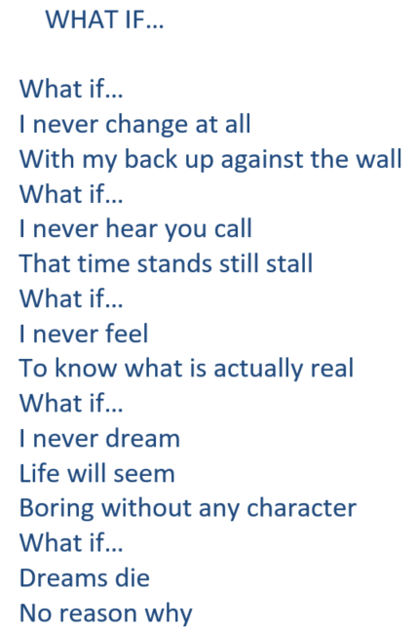
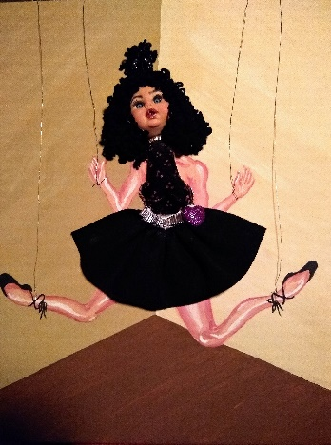
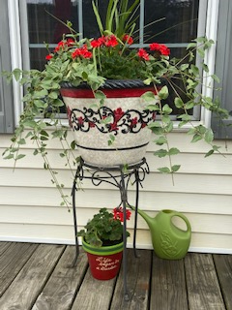
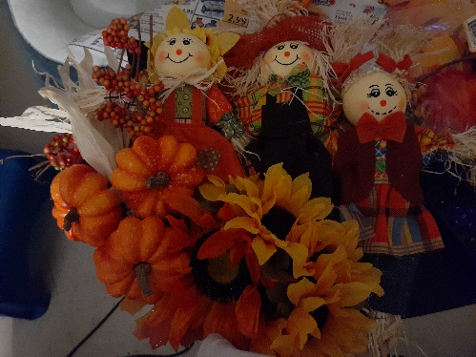
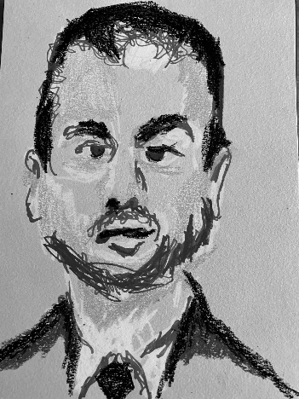







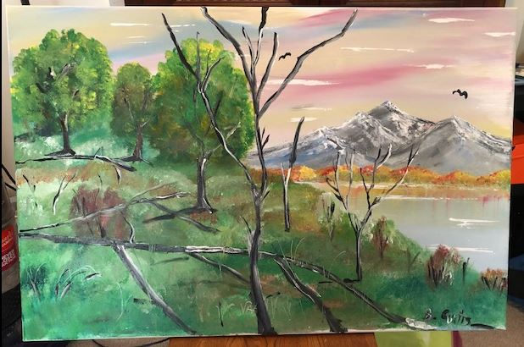
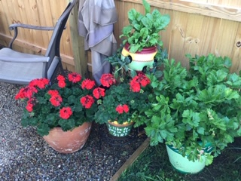
ArtAbility 2020
Poetry
Charcoal Sketches
Paintings
Hand-painted flower pots
Photography
Gardening
Baking
(with foreign translations)
Sewing
Crafts
Drawings

Slide 17

May is Mental Health Awareness Month

Slide 18

May- Mental Health Awareness Month
What is your agency/organization going to do?

Slide 19

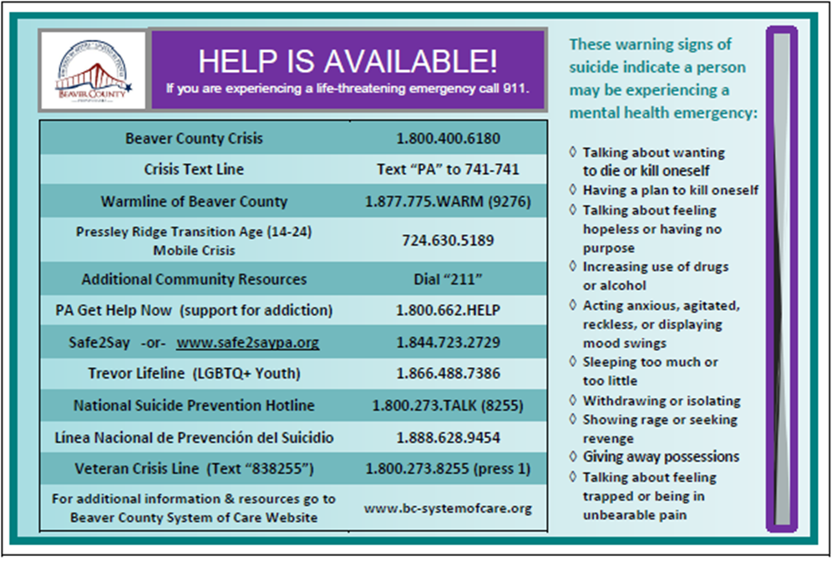
Marketing Committee
  Resource Cards
    Food Pantries
    ABC Associates
    MHA Lunch
    BCRC Vaccination Clinics
    Veterans Stand Down Event
  Next plan: PCP Offices
  If interested in obtaining the resource cards, contact Elisia Majors emajors@bcbh.org

Slide 20

Yard Sign Competition Update:
CHECK out the Video!!!
Make sure to get your sign!!
Help us spread awareness!
Distribution dates and locations to be announced soon

Slide 21
Community Outreach and Education Team
WE NEED YOU!!!!!!!!! Who wants to join the team???
Interested in joining the team?
  Email: Marcy at mscott@crscares.org
If you're not able to join the team, please share ideas or contacts that would be helpful to our outreach.
We've got some contacts and connections to reach out to veterans, youth and gun clubs.
Have any ideas on how to connect with local restaurants, bars, and business owners? If so, lets hear them!! Please share your contacts.

Slide 22

Trainings
QPR (Question, Persuade, and Refer)
  Partnering with Geneva College to offer training to Beaver County
  Last one held on 21st from 1-2:30pm
  Upcoming dates scheduled:
    May 21st from 1-2:30pm
    June 17th 10:30-12:00pm
  Flyer and registration information will be forthcoming
www.bc-systemofcare.org/training/

Slide 23



Upcoming Virtual Trainings
4/27/21 Trauma Informed Care
4/29/21 Developing the Capacity to Serve Others by Increasing Understanding of Cultural Competency
4/29/21 The Culture of Poverty
5/17/21 Safety First: Basic Suicide Prevention Training
5/19/21 Screening of – Suicide: The Ripple Effect
5/21/21 QPR Training
Upcoming In-Person Trainings
5/20/21 Mental Health First Aid

Slide 24
Beaver County System of Care: You Tube Channel
SOC YouTube channel:
https://www.youtube.com/watch?v=GY4rLQJRAcM&list=PL6lF8gWeCfKyHgu4A5RKl1SX7kH2BJrC-&index=2
Check out the archived webinars!
  Zero Suicide trainings
  System of Care trainings
  Co-Occurring Disorder Trainings

Slide 25

Check out the website: http://www.bc-systemofcare.org/
Send updates to: SOCwebmaster@ahci.org

Slide 26

Next meeting
May 21st at 10:30am
Zoom link will be sent

Slide 27

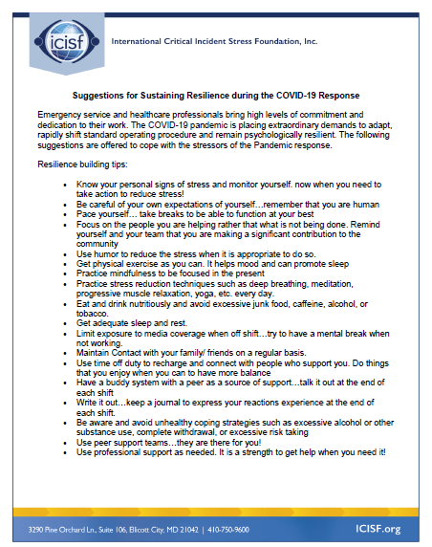


Slide 28

Resources
Please share the following resources with anyone who can benefit

Slide 29

Persevere PA Crisis Counseling Program (CCP) provides SAMHSA approved crisis counseling tele-health services, through the Center for Community Resources (CCR), and can be provided to people who need support related to the impacts of COVID-19. CCR provides the 24/7 Support and Referral Line that delivers the crisis counseling services.

Slide 30
Food Resources
https://www.agriculture.pa.gov/Food_Security/Pages/Resources.aspx
Mental Health Resources
https://www.pa.gov/guides/mental-health/
Unemployment Benefits
https://www.pa.gov/guides/unemployment-benefits/
COVID Testing
https://pema.maps.arcgis.com/apps/webappviewer/index.html?id=1a4c139769d646839e1549bcb6a668f1
COVID Guidance and Resources
https://www.pa.gov/guides/responding-to-covid-19/
PA COVID Resources

Slide 31
Resources
The Mental Health Support Line
Developed on April 1st
Can be reached toll-free, 24/7 at 1-855-284-2494 from anywhere in PA.
Crisis Text Line
Text PA to 741-741
PA Get Help Now Helpline
Can be reached toll-free at 1-800-662-HELP (4357).
A live chat option is also available online or via text message at 717-216-0905
Warmline of Beaver County
Can be reached at 1-877-775-WARM (9276)
Hours of operation 6pm-9pm
UPMC Beaver County Crisis
Can be reached toll-free, 24/7 at 1-800-400-6180

Slide 32
PA Resources
Many other resources also remain available to Pennsylvanians in need of support, including:
  National Suicide Prevention Lifeline: 1-800-273-TALK (8255)
  Línea Nacional de Prevención del Suicidio: 1-888-628-9454
  Crisis Text Line: Text “PA” to 741-741
  Safe2Say: 1-844-723-2729 or www.safe2saypa.org
  Veteran Crisis Line: 1-800-273-TALK (8255) (Press 1)
  Disaster Distress Helpline: 1-800-985-5990
  Get Help Now Hotline (for substance use disorders):
  1-800-662-4357

Slide 33
COVID Resources
https://www.cdc.gov/coronavirus/2019-ncov/daily-life-coping/managing-stress-anxiety.html
https://mhanational.org/covid19
https://psychhub.com/covid-19

Slide 34

What can we do to help?
E-mail us:
Elisia Majors
emajors@bcbh.org
Stephanie Santoro
ssantoro@ahci.org
Bonnie Palmieri
bpalmieri@ahci.org

Slide 35



Thank you!!
Stay Well!

