Slide 1

Incident Management
November 2020

Slide 2
Reminder
Why do we report in Beaver County?
Continuous Quality Improvement
Identification of trends and/or improvement opportunities
prevent future incidents
Improve system functioning
Monitoring to ensure member safety and high quality services
increase opportunities for intervention
Because it is required.

Slide 3
Two Reporting Methods*
SPA/eSP Incidents reported for people with a SPA. | No SPA /non-eSP Incidents reported for people without a SPA.
* Reporting to Beacon Health Options remains the same.

Slide 4
SPA/eSP incident reporting
http://www.bc-systemofcare.org/
eSP login
eSP Domains Screen-Crisis Plans / Critical Incidents / Early Warnings
eSP - Consumer Search
Click on SS#
Enter information
Click: Enter Incident
select Beaver Enter last name or SS# Capitalize first letter Search

Slide 5
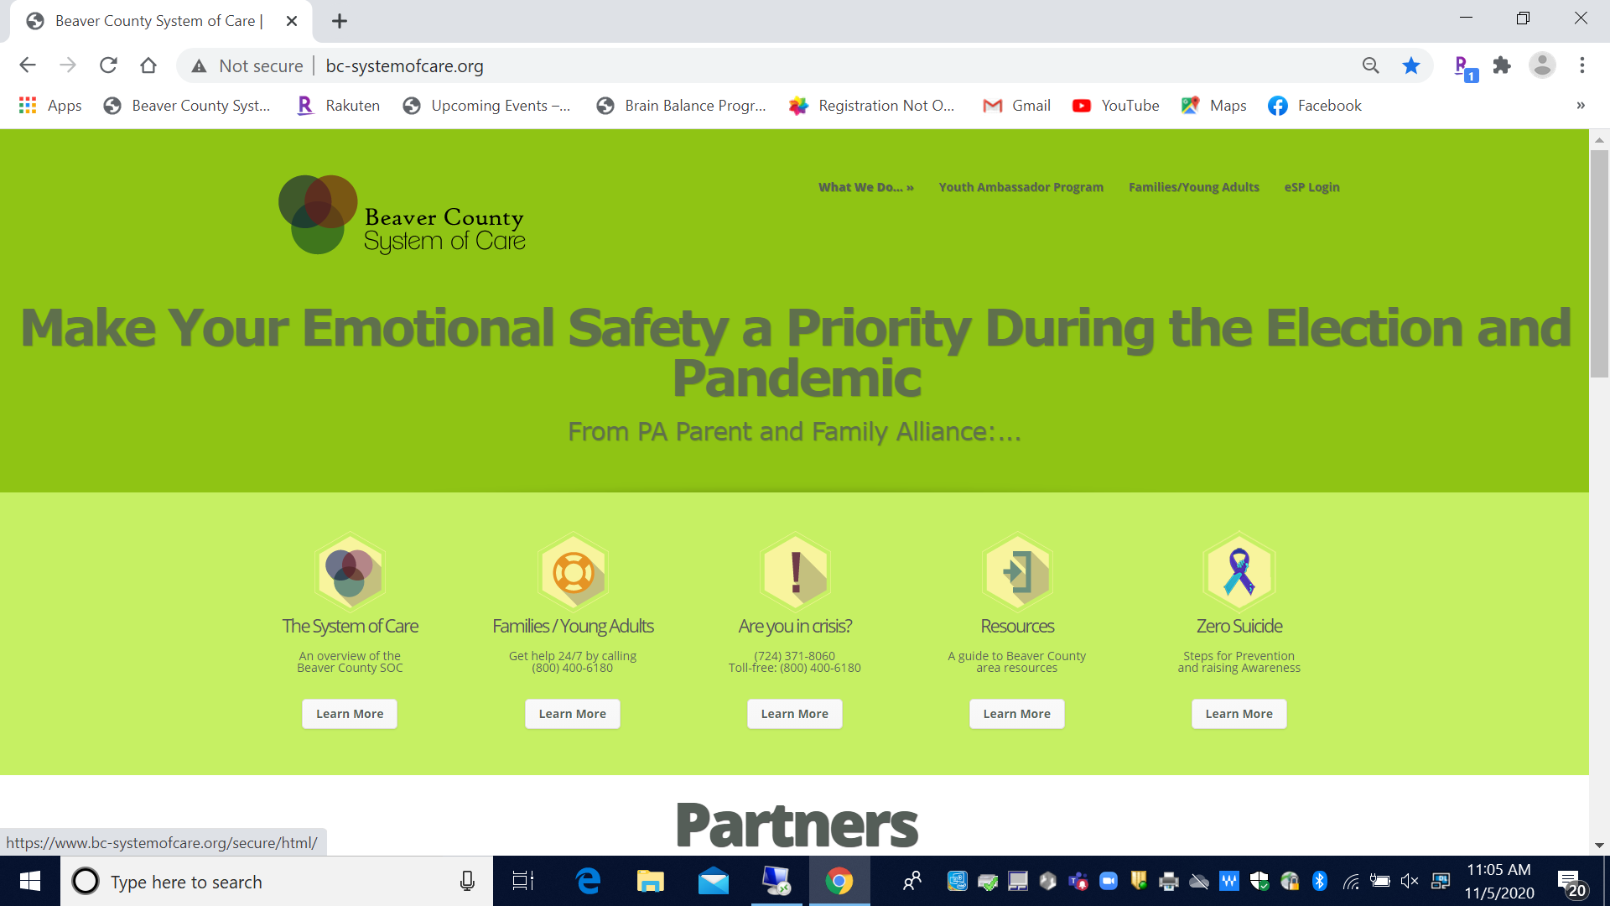
Step 1:
http://www.bc-systemofcare.org/

Slide 6
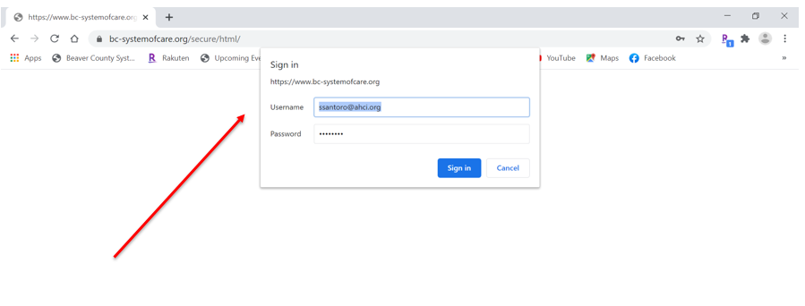
Step 2: Sign in

Slide 7
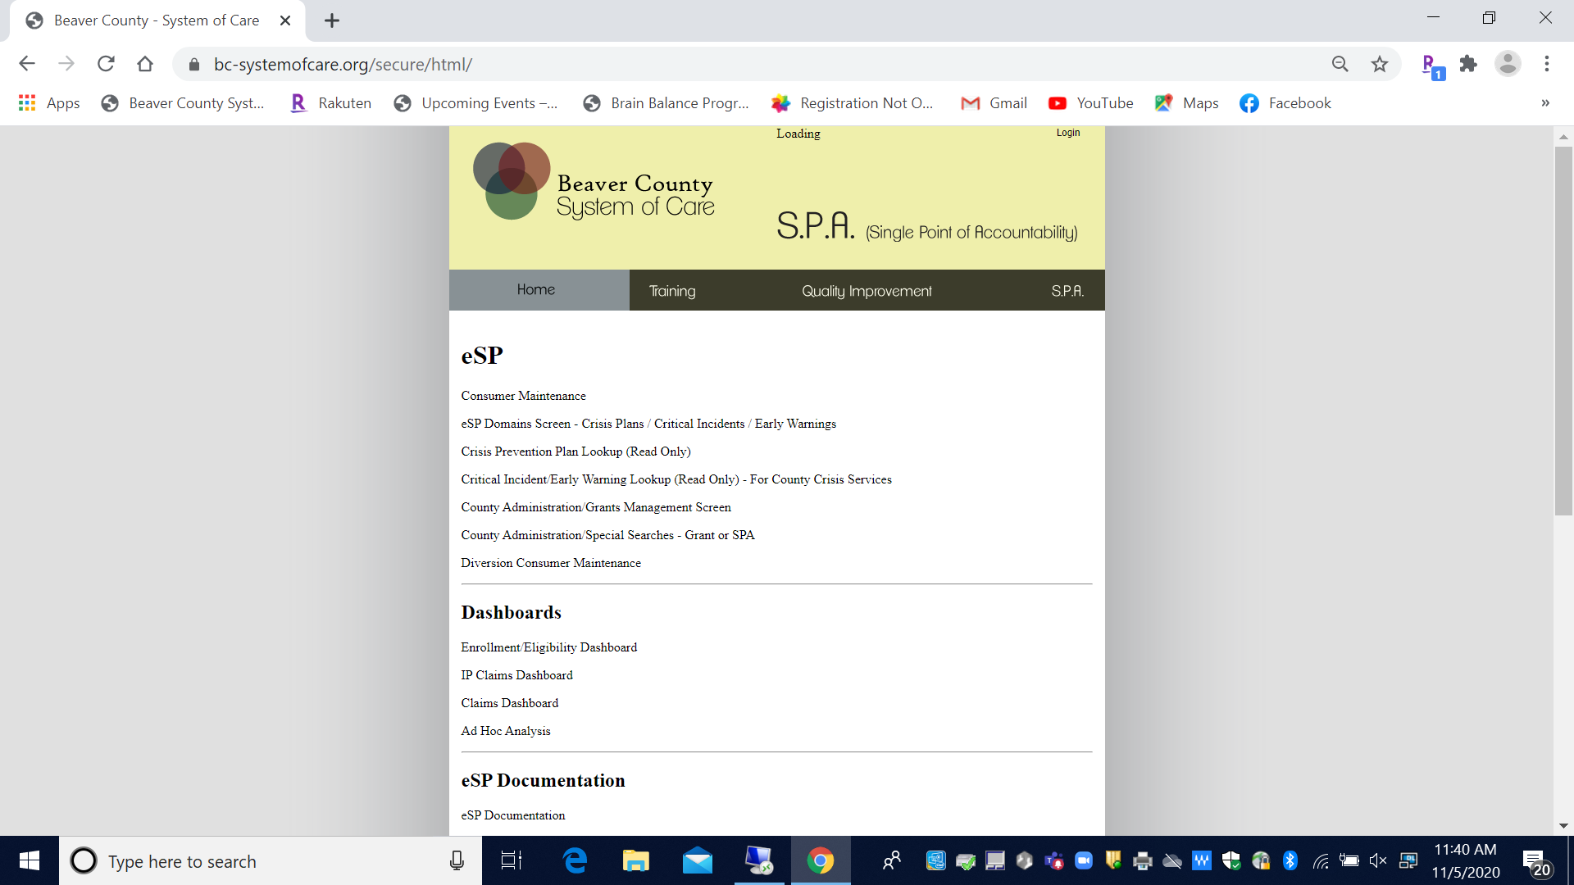
Step 3: eSP Domains Screen-Crisis Plans / Critical Incidents / Early Warnings

Slide 8
Incident Entry links
SPA domain page includes:
eSP ‘Critical Incident Entry’ and ‘Early Warning Entry’ links
Enter new incidents via these links
A SPA staff will only see/have access to their agency’s consumers.
eSP ‘Critical Incident Maintenance’ and ‘Early Warning Maintenance’ links
Make changes to an existing entry via these links.

Slide 9
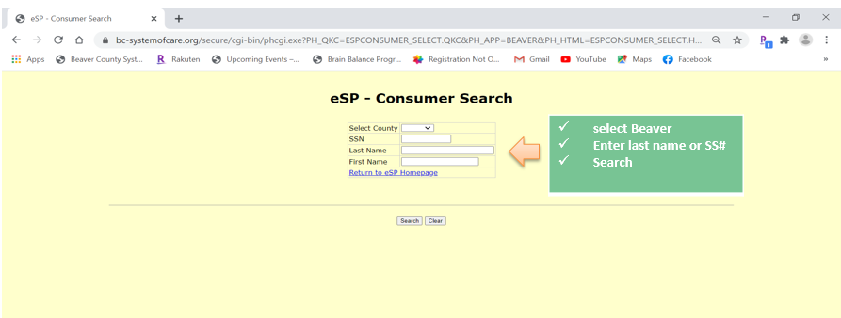
Step 4: Search
select Beaver Enter last name or SS# Search
Tips:
Capitalize first letter of last name.
Use the first 3 letters of the last name and @ if you don’t know the spelling Example: San@ can be used to search instead of Santoro

Slide 10
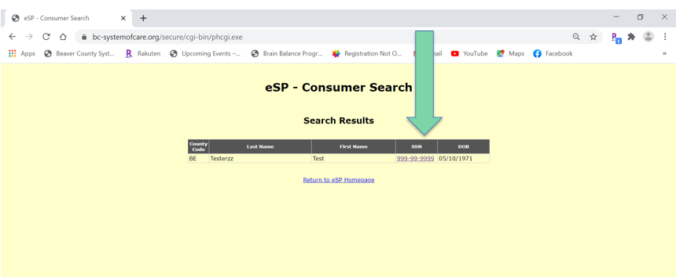
Step 5: Search Results

Slide 11
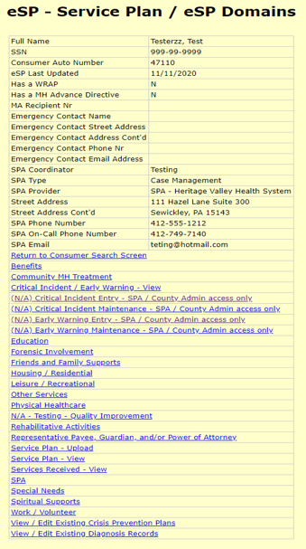
Step 6:
Click on
Critical Incident Entry
or
Early Warning Entry

Slide 12
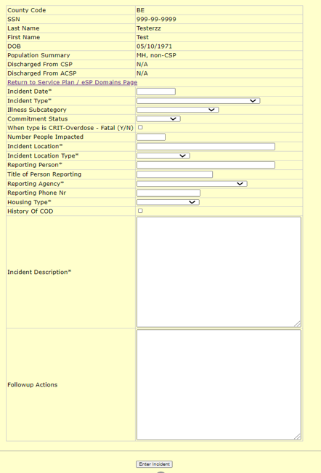
Step 7:
eSP – Critical Incident Entry
Enter incident information
Click on Enter Incident

Slide 13
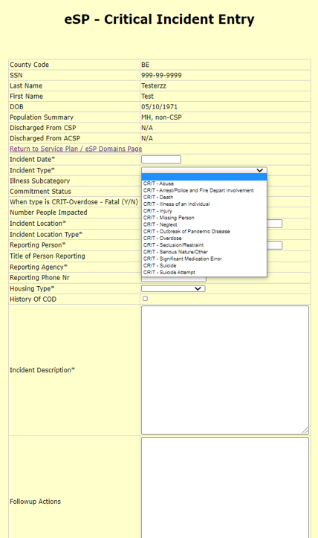
Critical Incident Type

Slide 14
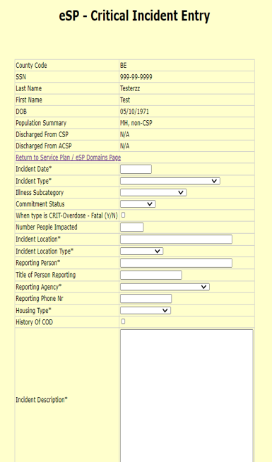
Illness Subcategory

Slide 15
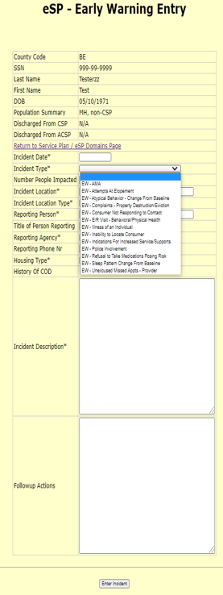
Early Warning Incident Type

Slide 16
Events of Interest (EOI)
INCIDENT_TYPEs that trigger an email notification:
CRIT - Arrest/Police and Fire Depart Involvement
CRIT - Suicide Attempt
CRIT - Death
CRIT - Significant Medication Error
CRIT - Missing Person
CRIT - Serious Nature/Other
CRIT - Suicide

Slide 17
Last Step:
Once the incident is entered, we get an alert and review the information entered.
We may contact you and ask for clarification.
We do the final step in submitting the incident.

Slide 18
No SPA/Non ESP
Type incident information into new reporting form
Send via secure email
Include Incident.type in the subject line
Examples: Incident.Arrest
Incident.AMA
To the attention of
AND
Elisia Majors
emajors@bcbh.org
Stephanie Santoro
ssantoro@ahci.org

Slide 19
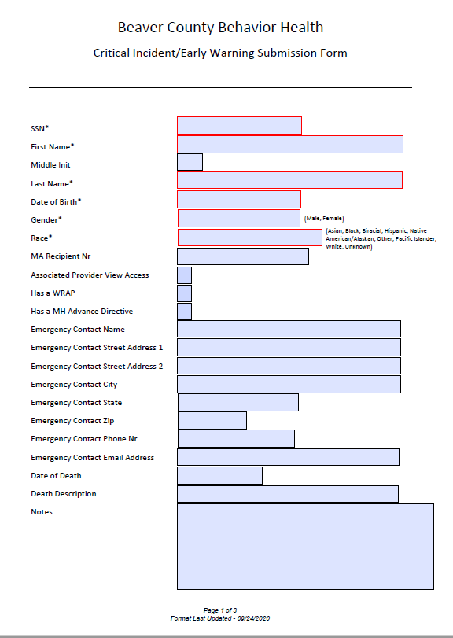
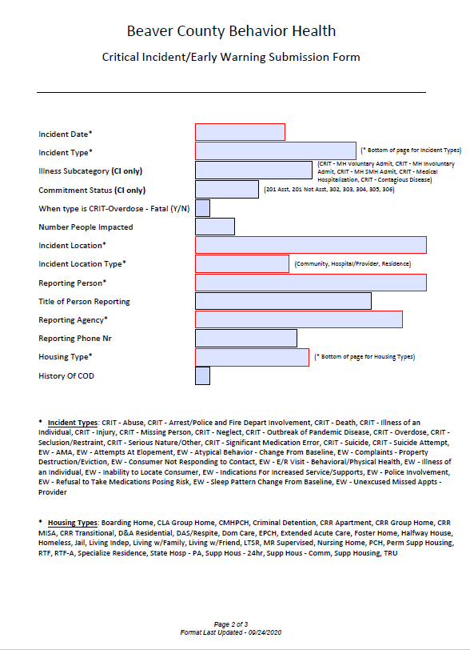
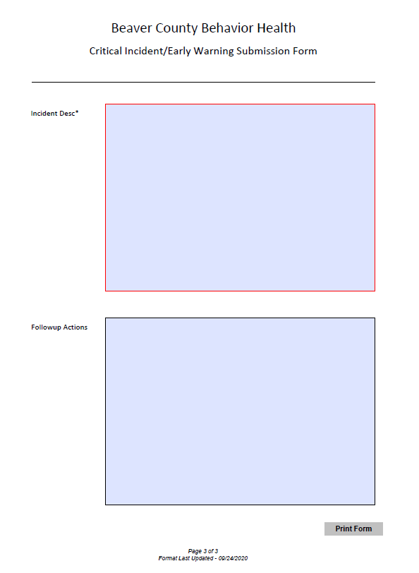
Reporting Form

Slide 20
Any questions?

