Slide 1

Zero Suicide Team Leaders
Beaver County
10/23/2020

Slide 2

Welcome!!!! ☺
Today’s meeting
  A reminder of how this works
Sign-in
Chat box

Slide 3
Today’s Agenda
Minutes
Partner Updates
Survey Results
Marketing Committee
Trainings
Website Update
Next Meeting

Slide 4
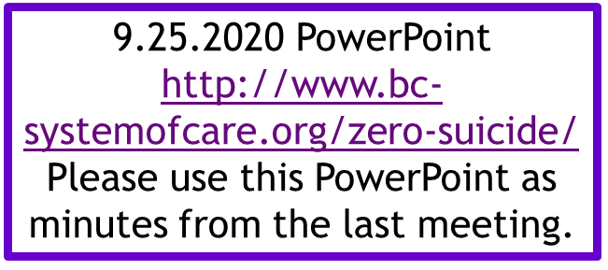


Name | Partner
Elisia Majors | BCBH
Jennifer Boeringer | ETC
Stephanie Santoro | AHCI
Bonnie Palmieri | AHCI
Rachel Kyle | HVHS-Staunton
Dave Aitken | NAMI
Abby Opal | MHA
Erin Rathbun | Beacon Health Options
Barb Reed | ABC Associates
Traci Hughes | BCRC
Dayna Brown | Pittsburgh Hires Veterans
Elizabeth Pelesky | HVB BH unit
Kelly Nardone | BCBH
Patty Hodovanich | Nicolina’s Wishes
Lauren Tomayko | Merakey
Melissa Coakley | Aurora
Staci Scheel | Women’s Center
Stephanie Hobil | PHN
Marissa Moyer | CRS
Joanne Koehler | MHA
Jaci Palmer | PRISM & Community Alternatives
Lynn Bourchier | CISM Butler Co.
Missy Watson | PHN
Angela Masciantonio | TPN
Jodi Platz | Community Alternatives

Slide 5
PARTNER UPDATES

Slide 6
American Foundation for Suicide Prevention
International Survivor of Suicide Loss Day
  Event taking place on November 21st, 2020
  In person and virtual event option
Also, we are partnering with the Pittsburgh Pastoral Institute called The Strengths that Keep us Going: Sources of Resiliency on December 3rd.
  Links to register:
  International Survivors of Suicide Loss Day: https://isosld.afsp.org/pittsburgh-pennsylvania/
  The Strengths that Keep us Going: Sources of Resiliency: https://www.eventbrite.com/e/the-strengths-that-keep-us-going-sources-of-resiliency-registration-122499881443?aff=AFSP&fbclid=IwAR0U5zeXKK3Jw3VNWMrz1UBWApUUOVzw7onTeQS5mD3_fuGvUuSbYSrLGR
VA Pittsburgh Healthcare System
Suicide prevention materials available
Contact Tony to request items: Ramon.Rivera5@va.gov
New contact as of November 8th: Bree.Piper@va.gov
Best wishes Tony!!!

Slide 7
Geneva College
Despite COVID, we are still open and doing very well! Students will be on campus until November 25th and then everyone will be heading home to complete finals the following week.
Our Assistant Director-Hannah Broadway is offering 6 opportunities during the last week of October for staff and faculty to be trained in QPR. We have trained so far 50 total students/faculty/staff in QPR. (from two previous trainings that have been completed this semester).
Amy Solman will be offering a virtual MHFA class for the entire campus on November 14th. We are continuing to use our social media platforms (Instagram and Facebook) to provide education, resources and hope to campus about suicide prevention and various other mental health issues.

Slide 8
Mental Health Association
Starting November, 2 we will be open 5 days a week.
Still with limited hours and requiring reservations, but back to Monday – Friday.
We are also collecting items for our Christmas baskets.
  While we will not be doing a party this year, we will be delivering baskets and a meal to our folks. We are collecting personal items and clothes, new is preferred.
Lets Talk About Mental Health
Event Held on October 10th
Went well

Slide 9
First Baptist
Last month, First Baptist had a free hair cutting day.
  Impactful day.
Sports Clips by the mall donated their time
3 additional FREE hair cutting days scheduled: October 26, November 23 and December 21.
  The time is 10-2.
  Location: First Baptist Church, 301 Adams St. Rochester, Pa 15074
    Enter through Vermont Street entrance.
  COVID protocols will be observed.
  Light refreshments will be served

Slide 10

Kuddos!!!

Slide 11
Marketing Committee
15,000 Resource Card were distributed!!
Distributed to:
  Local businesses
  Restaurants
  Schools
  Pharmacies
  PCP Offices
  Police Departments
  Human Services Providers
  Drug and Alcohol Providers
  Shelters
  And more…

Slide 12

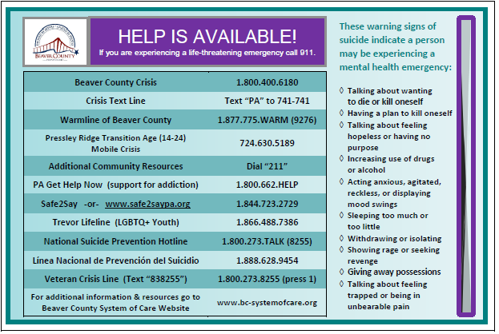
Resource Card

Slide 13
Marketing Committee
Next Steps:
  Thank you Video
    Create a THANK YOU video to recognize everyone who participated
    Video will be shared on website and social media
  Resource Cards
    Holiday Meals
    Toy Drives
  Posters
    Schools
    Colleges
    Provider Offices

Slide 14
9.10.2020
Town Hall Survey Result

Slide 15
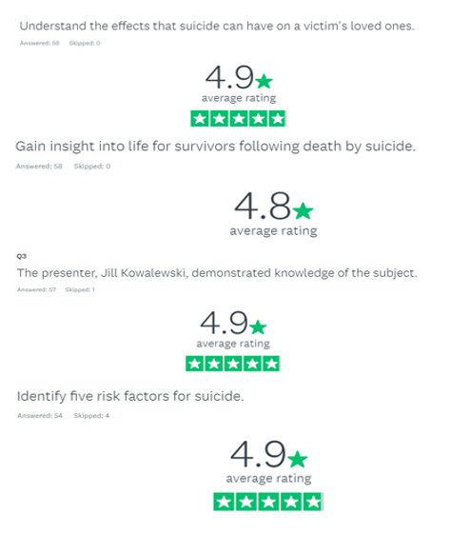

Slide 16
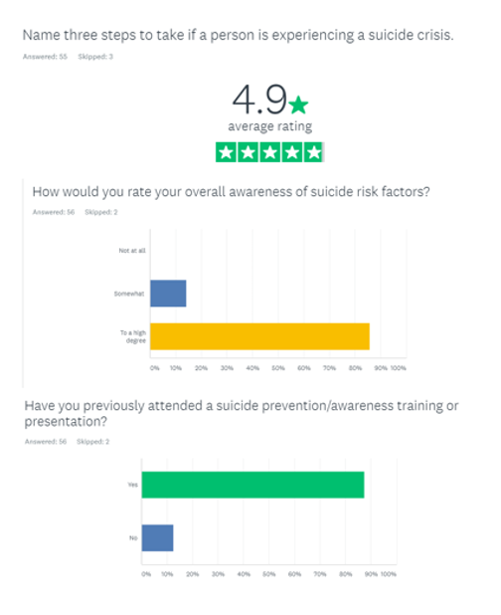
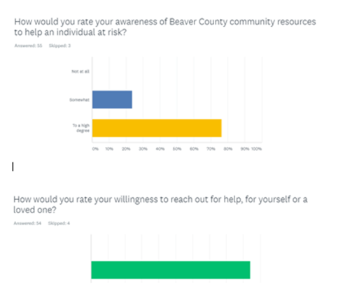


Slide 17
Future Trainings
Mental Health First Aid/Youth Mental Health First Aid
  BC SOC instructors have to be trained in virtual MHFA.
  Once they have completed their training, we will be able to offer the training virtually
  More information will be coming soon
Other Trainings to target:
  Youth
  First Responders
  Providers
  General Community

Slide 18

Website Update

Slide 20
New Survey Finds Most Americans Want Suicide Prevention to Be a National Priority
A new national survey of over 2,000 U.S. adults found the majority of those surveyed (81%) believe, as a result of COVID-19, it is now more important than ever to make suicide prevention a national priority. The survey was conducted by The Harris Poll on behalf of the National Action Alliance for Suicide Prevention (Action Alliance), the American Foundation for Suicide Prevention (AFSP), the Suicide Prevention Resource Center (SPRC), and Education Development Center (EDC). The survey data also show 52% of respondents report being more open to talking about mental health as a result of COVID-19. These important data reinforce that Americans know they play a key role in strengthening suicide prevention and mental health, especially as the pandemic continues to take a toll on many people’s health and well-being.
As the data show, most Americans believe suicide can be prevented (93%) and would do something if someone close to them was thinking about suicide (95%). However, many people (69%) identified key barriers to talking about suicide, such as not knowing what to say (31%), feeling they don’t have enough knowledge (28%), or not feeling comfortable with the topic (19%). You can play a role today in helping to reduce those barriers by sharing tips and resources that empower all Americans to take action to support themselves and others. We all play a role!
Tips and resources can be found at: https://theactionalliance.org/bethere

Slide 21
Suicide Prevention Resource Center
SPRC is pleased to announce the launch of its new online tool, Virtual Learning Lab: Care Transitions. This module can help psychiatric hospital staff ensure a support system, appropriate hand-off communication, and safety plans are in place when individuals at risk of suicide transition from inpatient to outpatient care.
This self-paced training is designed for hospital staff, such as social workers, clinical nurses, therapists, and discharge planners.
However, much of the information is also applicable to staff in other settings working with people at risk who will be discharged or transition to another treatment setting or level of care.
  http://www.sprc.org/training/virtuallearninglabs

Slide 22

Registration link:
https://us02web.zoom.us/webinar/register/WN_CXsvbO4PRj2Eeu_CL5ayhw

Slide 23

Persevere PA Crisis Counseling Program (CCP) provides SAMHSA approved crisis counseling tele-health services, through the Center for Community Resources (CCR), and can be provided to people who need support related to the impacts of COVID-19. CCR provides the 24/7 Support and Referral Line that delivers the crisis counseling services.

Slide 24

Check out the website: http://www.bc-systemofcare.org/
Send updates to: SOCwebmaster@ahci.org

Slide 25

What can we do to help?
E-mail us:
Elisia Majors
emajors@bcbh.org
Stephanie Santoro
ssantoro@ahci.org
Bonnie Palmieri
bpalmieri@ahci.org

Slide 26
Resources
The Mental Health Support Line
Developed on April 1st
Can be reached toll-free, 24/7 at 1-855-284-2494 from anywhere in PA.
Crisis Text Line
Text PA to 741-741
PA Get Help Now Helpline
Can be reached toll-free at 1-800-662-HELP (4357).
A live chat option is also available online or via text message at 717-216-0905
Warmline of Beaver County
Can be reached at 1-877-775-WARM (9276)
Hours of operation 6pm-9pm
UPMC Beaver County Crisis
Can be reached toll-free, 24/7 at 1-800-400-6180

Slide 27
PA Resources
Many other resources also remain available to Pennsylvanians in need of support, including:
  National Suicide Prevention Lifeline: 1-800-273-TALK (8255)
  Línea Nacional de Prevención del Suicidio: 1-888-628-9454
  Crisis Text Line: Text “PA” to 741-741
  Safe2Say: 1-844-723-2729 or www.safe2saypa.org
  Veteran Crisis Line: 1-800-273-TALK (8255) (Press 1)
  Disaster Distress Helpline: 1-800-985-5990
  Get Help Now Hotline (for substance use disorders):
  1-800-662-4357

Slide 28
COVID Resources
https://www.cdc.gov/coronavirus/2019-ncov/daily-life-coping/managing-stress-anxiety.html
https://mhanational.org/covid19
https://psychhub.com/covid-19

Slide 29



Thank you!!
Thank you!!
Thank you!!

