Slide 1

Zero Suicide Team Leaders
Beaver County
8/28/2020

Slide 2
Welcome!!!! ☺
Today’s meeting
A reminder of how this works
Sign-in
Chat box

Slide 3
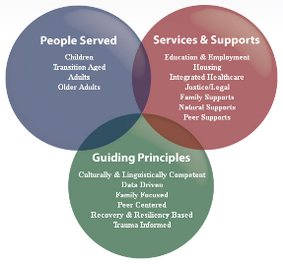
Today’s Agenda
Minutes
Partner Updates
Marketing Committee
September 10, 2020, World Suicide Prevention Day
Next Meeting

Slide 4
Name | Partner
Elisia Majors | BCBH
Jennifer Boeringer | ETC
Stephanie Santoro | AHCI
Rachel Kyle | HVHS-Staunton
Dave Aitken | NAMI
Abby Opal | MHA
Erin Rathbun | Beacon Health Options
Barb Reed | ABC Associates
Jonathan Hughes | TPN
Colby Jones | Merakey
Heather Prince | TPN
Traci Hughes | BCRC
Jan McGinnis | Catholic Charities
Tony Rivera | VA Pgh Healthcare Services
Daniel McClure Neff | Southwood
Bonnie Palmieri | AHCI
Nora Stocum | Wesley Family Services
Jayme White | White Deer Run & Jason Foundation
Marcy Scott | CRS
Melissa Grimes | CRS
Elizabeth Pelesky | HVB BH unit
Amy Solman | Geneva College
Jesse Putkoski | AFSP
Jessica Weller | Pressley Ridge
Johanna Guarino | BBBS
Susan Smith | BCRC
Liz Pelesky | HVHS
Kelly Nardone | BCBH
7.31.2020 PowerPoint
http://www.bc-systemofcare.org/zero-suicide/
Please use this PowerPoint as minutes from the last meeting.

Slide 5
PARTNER UPDATES

Slide 6
American Foundation for Suicide Prevention
Updates for events surrounding the Lawrence County Out of the Darkness Experience.
We’ve scheduled three Talk Saves Lives presentations that will be taking place during the weeks leading up to and following the ceremony that is still set to take place on September 26th.
We are still determining if there will be an in-person component for that and updates will be shared as soon as possible
Additional events are being still getting scheduled
If people want to register for the experience, they can go to https://afsp.org/newcastle
Here are the registration links for the 3 upcoming Talk Saves Lives presentations:
September 8th from 12pm to 1pm: https://tsl-lawootd908.attendease.com/
September 21st from 10am to 11am: https://tsl-lawootd921.attendease.com/
September 28th from 3pm to 4pm: https://tsl-lawootd928.attendease.com/

Slide 7

VA Pittsburgh
VA Pittsburgh will be placing a billboard along Route 18 southbound in Big Beaver advertising the Veterans Crisis Line.
The billboard will be up from August 31st – September 27th

Slide 8
Heritage Valley Health System
We will now be offering all outpatient therapy - individual and groups at all locations with in-person, telehealth, and/or Zoom options as of August/September, this includes IOP, DBT, and Adolescent IOP.
DBT will be moving to a rolling enrollment rather than the previous format with 3 closed, 6 month groups. The hope is that this will enhance access to the groups which was previously a barrier.
All mobile services have in-person and telehealth options. BSCs can use Zoom to support with large team meetings where social distancing could be a concern. In-person and video are preferred means of contact, clients have been engaged and able to follow COVID-19 Precautions
High Risk Committee continues to meet to support increasing client needs with input from the larger, multidisciplinary team
Continued Wellness and Cultural Change calls to support staff needs/wellness

Slide 9
PRISM
Continues to meet every two weeks. We now are meeting in person again using CDC guidelines. We meet up in person, then two weeks after that we meet virtually. This will be ongoing until things change in regards to COVID.
We continue to have group text messages where the students can reach out to their peers for support also.
We have made PRIDE bags with some support items, notebooks to journal in, etc.
These kids have really been struggling with the lack of support and socialization. It is so important that we continue to be present and out there so that the youth know that they have support.
Community Alternatives
We will be providing E-Mentoring (virtual mentoring) for any students that are in need of extra support.

Slide 10
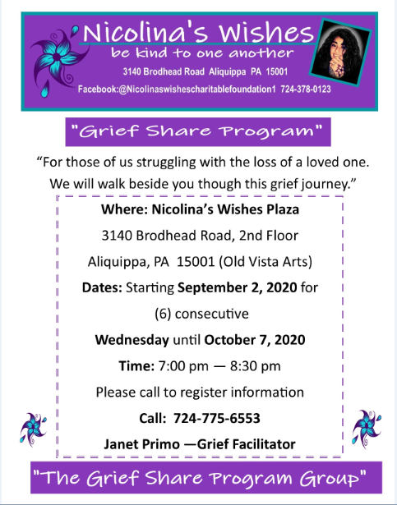

Slide 11
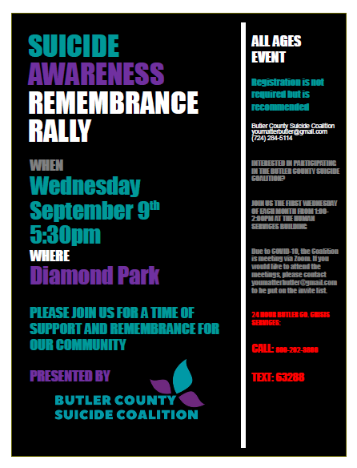

Slide 12
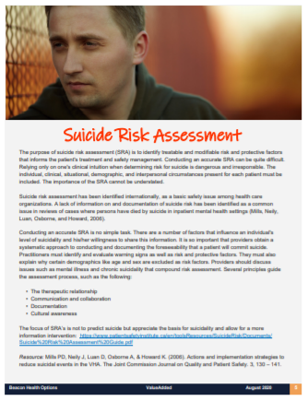

Beacon Health Options of PA
August ValueAdded Newsletter

Slide 13
SOC Website:
“How’s That Working for You?” will be an ongoing “Peers in Recovery” feature of the Beaver County System of Care Website. Currently, it’s a scrolling announcement, or Post. It will be converted to a Post to a Page at any time, not losing the work already done. Each month, we will feature someone different on the “How’s That Working for You?” Post. The eventual result will be combining it all into a whole gallery of local peers, living a self-directed life in RECOVERY. The reader can click on each person featured in the gallery and visit his/her Page.
NOTE: A peer does not have to be a CPS/CRS to be featured on “How’s That Working for You?” Nominations are appreciated at: 724.624.7203 or bpalmieri@ahci.org . Let’s build a gallery of HOPE together!
This title was selected to emphasize that there are many strategies to wellness, no two recovery stories are the same, and taking personal responsibility is important. Hopefully, some common threads will stand out (people who helped, for example).
And here’s more GOOD NEWS!!! We will be able to do ArtAbility 2020 virtually this year. Folks should be encouraged to continue making art and this year, entries will be featured on the System of Care Website! Each artist will submit photos of his/her work and each artist will have his/her own webpage. Instead of “strolling” through the gallery, viewers will be “scrolling” through the gallery!!!! Art can be sent to artability@ahci.org

Slide 14

Kuddos!!!

Slide 15
Marketing Committee
Group met twice in August
Beaver County Zero Suicide Committee Logo
Resource Card
Discussed places to distribute the card
Local businesses
Restaurants
Schools
Pharmacies
PCP Offices

Slide 16

Committee Logo

Slide 17
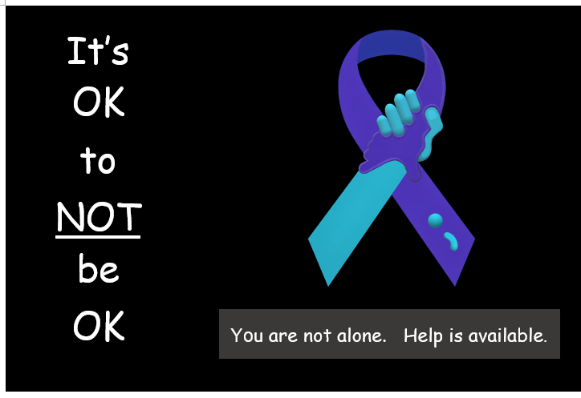
Resource Card- Front

Slide 18
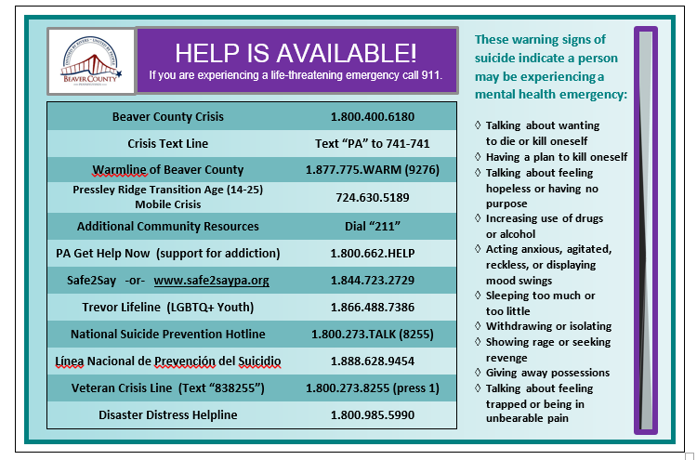
Resource Card-Back

Slide 19

World Suicide Prevention Day: September 10, 2020
Working Together to Prevent Suicide
Notes:
Guest speakers: Jill, Mandy; 2-3 hours
Encourage partners to identify what they can do in September to raise awareness & education. Give ideas.
Resources available
Reconvene marketing committee.

Slide 20
Beaver County Zero Suicide Town Hall
When: September 10, 2020
Time: 10am to 1pm
Tentative agenda for the day
To register: https://link.zixcentral.com/u/02b9067f/pAKdscPc6hGsm-Y2My1kxg?u=https%3A%2F%2Fform.jotform.com%2F202224639078153
Virtual Vendor Exhibit – send us your slide(s)
Questions, feedback

Slide 21

September is Suicide Prevention Month
What is your agency going to do to raise awareness during the month of September?
International Association for Suicide Prevention
shares some tips:
https://www.iasp.info/wspd2020/take-a-minute/

Slide 22
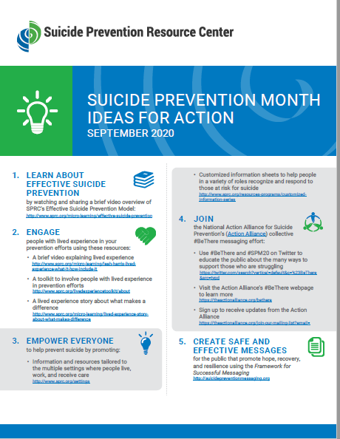
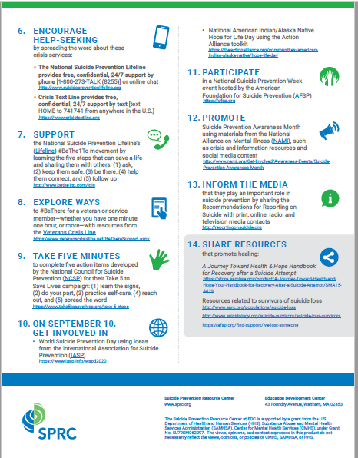

Slide 23

Check this out!
The Jana Marie Foundation, Prevent Suicide PA, Pennsylvania Network for Student Assistance Services (PNSAS), and Garrett Lee Smith (GLS) Youth Suicide Prevention Grant are pleased to share a resource guide for communities for National Suicide Prevention Month. Within the month of September, the week of September 6th-12th is recognized as National Suicide Prevention Week, with Thursday, September 10th marking World Suicide Prevention Day.
The resource guide provides examples of activities that you can implement in your community to raise awareness of the importance of suicide prevention. This includes ideas for training, social media posts, virtual backgrounds, a sample proclamation, and more.
https://janamariefoundation.org/wp-content/uploads/2020/08/Suicide-Prevention-Guide-Final-2020.pdf

Slide 24

Trainings
Lots of virtual trainings are available:
American Foundation for Suicide Prevention
VA Pittsburgh Healthcare System
JED Foundation
Suicide Prevention Resource Center
Beaver County System of Care
Zero Suicide:
Applying Zero Suicide in the Pediatric Setting
Treating Suicidal Patients During Covid 19-Best Practices and Telehealth
18 different ones listed—Check them out!! http://zerosuicide.edc.org/resources?type_1%5B%5D=webinar
Keep an eye out!!
There are a TON of
virtual trainings available!!

Slide 25

Check out the website: http://www.bc-systemofcare.org/ Send updates to: SOCwebmaster@ahci.org

Slide 26

What can we do to help?
E-mail us:
Elisia Majors
emajors@bcbh.org
Stephanie Santoro
ssantoro@ahci.org
Bonnie Palmieri
bpalmieri@ahci.org

Slide 27
Resources
The Mental Health Support Line
Developed on April 1st
Can be reached toll-free, 24/7 at 1-855-284-2494 from anywhere in PA.
Crisis Text Line
Text PA to 741-741
PA Get Help Now Helpline
Can be reached toll-free at 1-800-662-HELP (4357).
A live chat option is also available online or via text message at 717-216-0905
Warmline of Beaver County
Can be reached at 1-877-775-WARM (9276)
Hours of operation 6pm-9pm
UPMC Beaver County Crisis
Can be reached toll-free, 24/7 at 1-800-400-6180

Slide 28
PA Resources
Many other resources also remain available to Pennsylvanians in need of support, including:
National Suicide Prevention Lifeline: 1-800-273-TALK (8255)
Línea Nacional de Prevención del Suicidio: 1-888-628-9454
Crisis Text Line: Text “PA” to 741-741
Safe2Say: 1-844-723-2729 or www.safe2saypa.org
Veteran Crisis Line: 1-800-273-TALK (8255)
Disaster Distress Helpline: 1-800-985-5990
Get Help Now Hotline (for substance use disorders):
1-800-662-4357

Slide 29
COVID Resources
https://www.cdc.gov/coronavirus/2019-ncov/daily-life-coping/managing-stress-anxiety.html
https://mhanational.org/covid19
https://psychhub.com/covid-19

Slide 30



Thank you!! Thank you!! Thank you!!

