Slide 1

Zero Suicide Team Leaders
Beaver County
5/15/2020

Slide 2
Welcome!!!! ☺
Today’s meeting
  How is this going to work?
Sign-in
Chat box

Slide 3
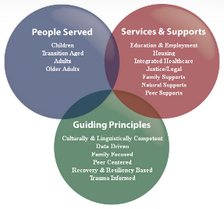
Today’s Agenda
Minutes
Partner Updates
Mental Health Awareness Month
Marketing Committee
Beaver County System of Care Website
Survey Results
Trainings
September 10, 2020, World Suicide Prevention Day
Screenings- Suicide: The Ripple Effect

Slide 4
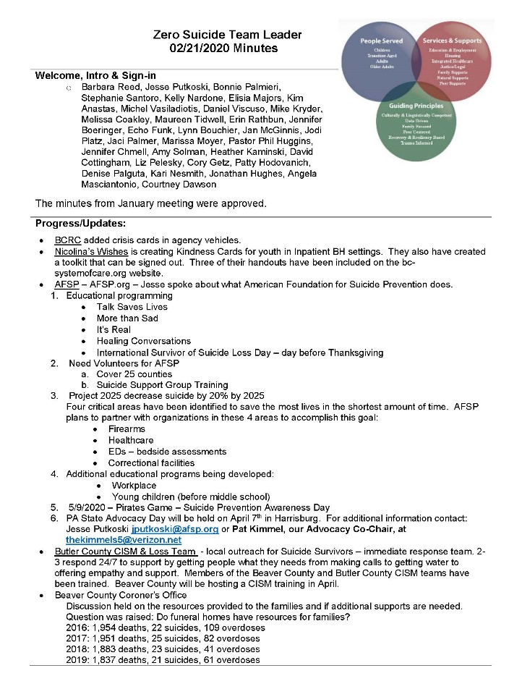
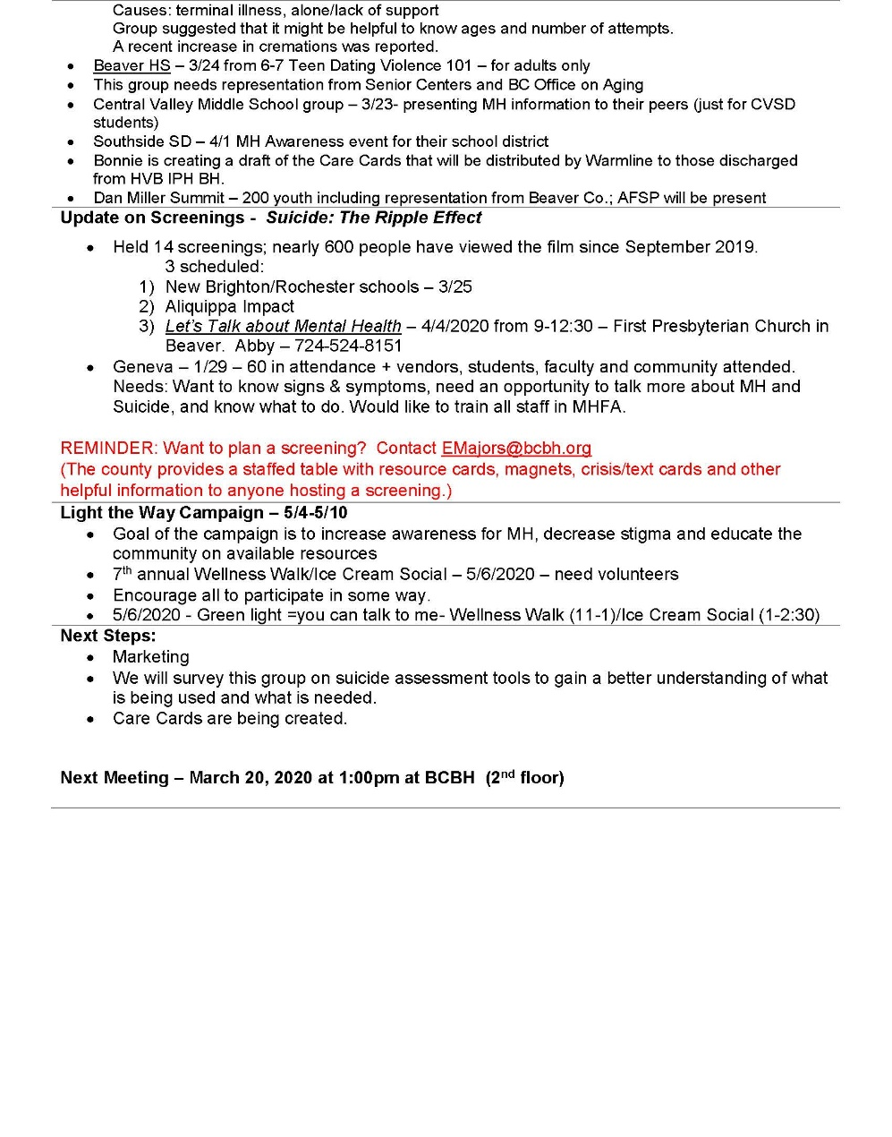

Slide 5
Partner Updates
American Foundation for Suicide Prevention
#RealConvo
  For May, Mental Health Awareness month, AFSP shares tools, resources and creative ways to have a #RealConvo with the people in your life.
  The resources include guides, videos, and tips on how to have an open, authentic conversation about mental health. https://afsp.org/realconvo/?utm_source=All+Subscribers&utm_campaign=2846835195-Research_Connection_July_COPY_01&utm_medium=email&utm_term=0_3fbf9113af-2846835195-385583759
AFSP is providing local restaurants with flyers that include AFSP’s Mental Health & COVID-19 website, national and local resources
  Encouraging the flyers to be included in their takeout and to-go orders.
  Here is the website link: https://afsp.org/mental-health-and-covid-19
AFSP (East Central Division, including Western Division) is hosting a number of virtual educational presentations in the coming months.
  Training will be held twice a week
  Trainings vary from the Talk Saves Lives program, which includes a standard version, an LGBTQ version, and a Seniors version,
    More Than Sad for Parents and It’s Real College Film.
  Anyone from any of the chapters in the division can register to attend these presentations.
  A lot of the trainings are already listed on their website at https://afsp.org/westernpa

Slide 6
Partner Updates
VA Pittsburgh Healthcare System
  Operation S.A.V.E. gatekeeper training
    Offering this virtual training free for an organizations that are interested.
    Though the training is geared towards Veterans, it is also perfectly acceptable for non-Veteran populations as well.
  Standing Together for Suicide Prevention podcast are starting.
    Looking for organizations to participate or stories to feature
  They also have free gunlocks available.
  Toolkit for Safe Firearm Storage in Your Community
    file:///C:/Users/bcbhe/Downloads/Toolkit_Safe_Firearm_Storage_CLEARED_508_2-24-20.pdf
  Anyone interested in scheduling training, participating in a podcast, or obtaining gunlocks, please contact Tony Rivera at Ramon.Rivera5@va.gov

Slide 7
Provider Updates
PRISM
Meeting virtually every Saturday evening from 6:00-8:00pm as well as having multiple group texts to keep communication and support present.
PRISM Leaders plan to drop of “Care/Art Bags” this week to our youth.
  Inside will be materials for a group art project, inspirational card, candy, and some other fun things to remind the youth that they are thought of and we are still here for them.
With the uncertainty of Pittsburgh Pride this year, PRISM is raising funds to at the very least have a PRIDE Picnic here in our county for the LGBTQIA+ community.
  As of now, planning to hold the event in the middle of August.
For additional information, contact Jaci Palmer at j.palmer@communityalt.org or 724-759-5228
PRISM continues to partner with Central Outreach Wellness Center in Aliquippa, where our new office is housed.
Central Outreach
They provide culturally competent health care with dignity and respect. They strive to understand and support a wide range of clients' cultural and personal beliefs. They foster the LGBTQIA and HIV+ patient by understanding the unique needs of those clients. They also support harm reduction as well as recovery and no one is judged or shunned by their personal behaviors; because they know trust is a process that takes time and effort to nurture.
Physician staff specialize in HIV and Hep C care
They can be reached at 724-707-1155 or online at centraloutreach.com

Slide 8
Provider Updates
Staunton Clinic
  Since all sessions are on the phone/video throughout the program, staff are making sure to screen where the client is during the call. Both to ensure their privacy/safety (not in public or driving) and to ensure that if the client indicates the need for a safety check/302 we can act in an informed manner.
Primary Health Network
  Psych Nurse practitioner Brittany Peebles- Started this week, Beaver Falls and Autumn Street (Aliquippa) sites. Seeing patients ages 18 and up.
  Psych Nurse practitioner Ashley Woods- starting June 5th at Rochester BH office. Seeing patients ages 14 and up.
Wesley Family Services
  Providing telehealth services and able to accept Beaver County Family Based referrals immediately.
Catholic Charities
  Able to provide telehealth services and accepting referrals

Slide 9

Mental Health Awareness Month
May is Mental Health Awareness Month
  Awareness activities happening throughout the month
  Youth Ambassadors Mental Health Awareness
    Central Valley Middle School
  Light the Way Campaign
    Beaver County Commissioners Proclamation
  Check out the website and social media sites for more additional activities
  What’s your agency doing? Let us know!

Slide 10


Youth
Mental Health
Awareness Activities

Slide 11

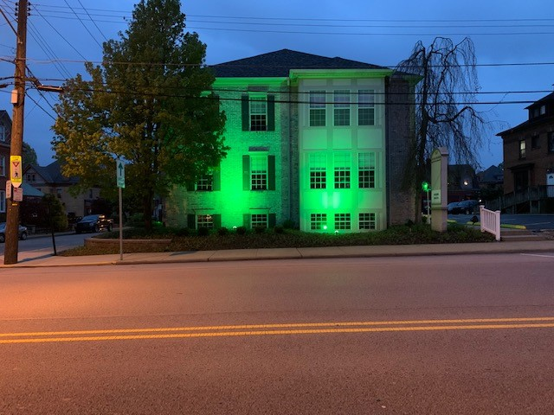

Light the Way Campaign
Thank you Aurora and BCRC!

Slide 12


Slide 13
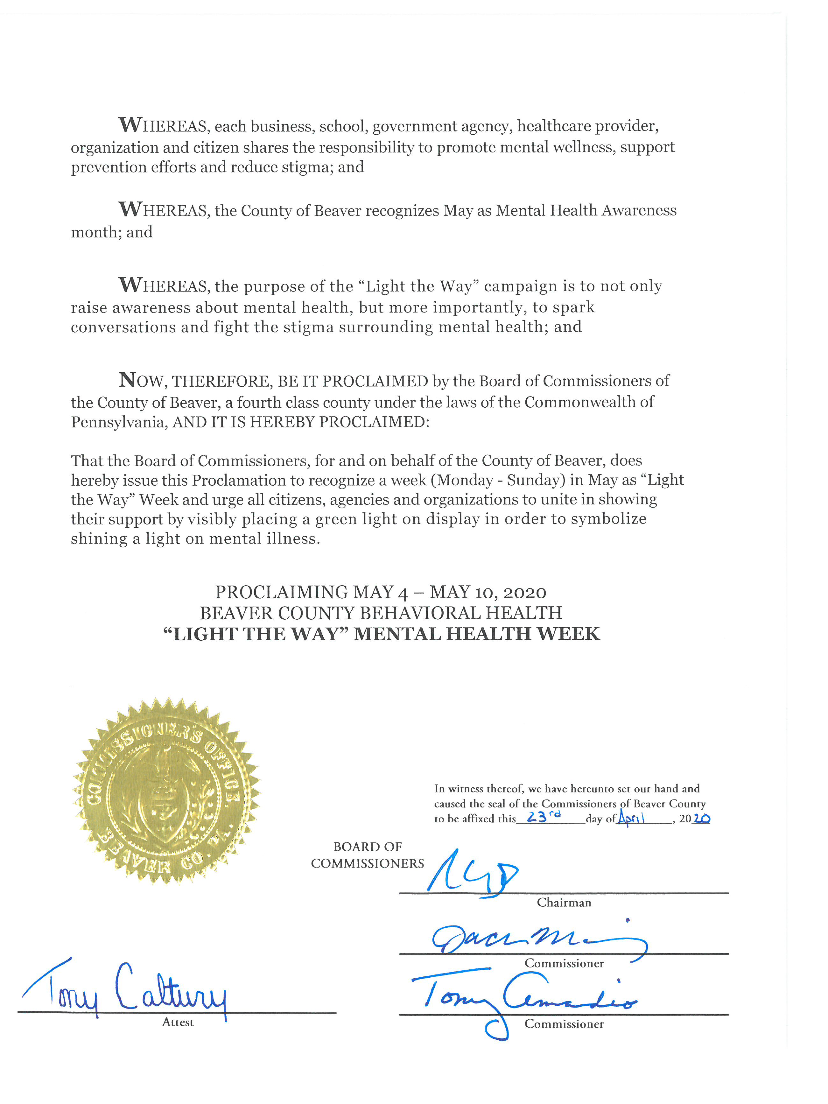

Slide 14


Slide 15
Marketing Committee
Meeting held in March
Goals: Increase awareness, education in the community, reduce suicide attempts and deaths
Marketing ideas: Poster campaign, Social media and on-line marketing campaign, t-shirt sale
  Discussed the various community sites & materials will be distributed
  T-shirt sale update
Suggested populations to target: elderly, youth, rural communities, minority groups
  Plan to hold focus groups to get feedback on posters, needs, and concerns

Slide 16
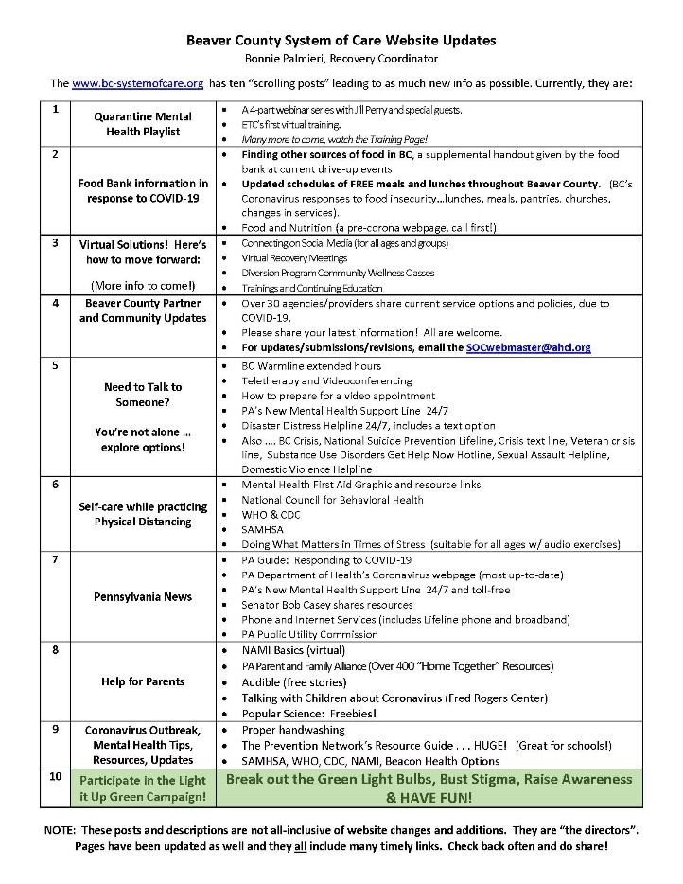
Check out the website: http://www.bc-systemofcare.org/
Send updates to: SOCwebmaster@ahci.org

Slide 17
Survey
13 respondents:
  Merakey
  Nicolina’s Wishes
  HVHS –
  Staunton-Edgeworth x 2
  Butler Co. CISM
  ABC Associates
  Catholic Charities
  HMHH
  GRLS
  BC CYS
  Pressley Ridge
  BCBH
  Aliquippa Impact

Slide 18
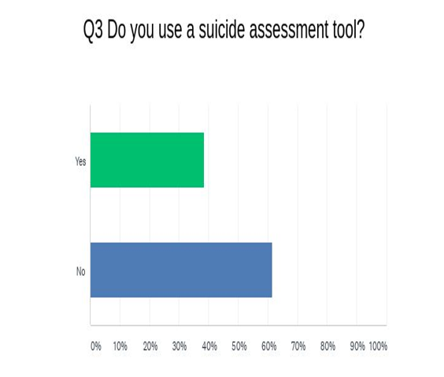
PHQ9
Safe-T
Suicide/Homicide Risk Assessment

Slide 19
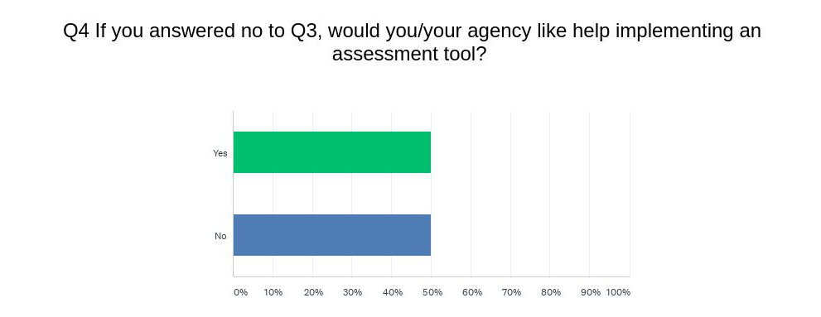

Slide 20
Q5: If you answered yes to Q3, when is the assessment administered?
Intake and at least every 6 months thereafter
When a person is in crisis
All the time
Intake and at least 3 times/year and it is attached to every progress note
Ongoing throughout treatment

Slide 21
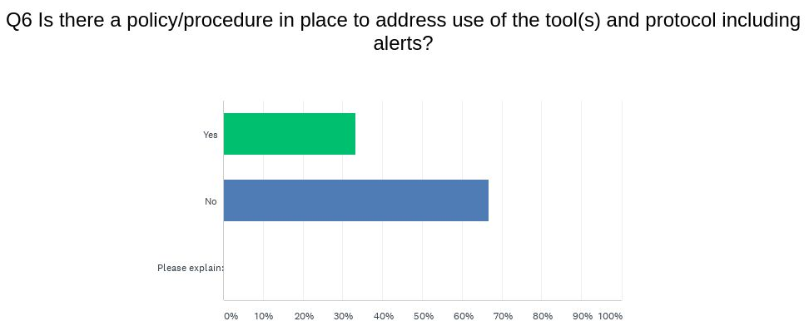

Slide 22
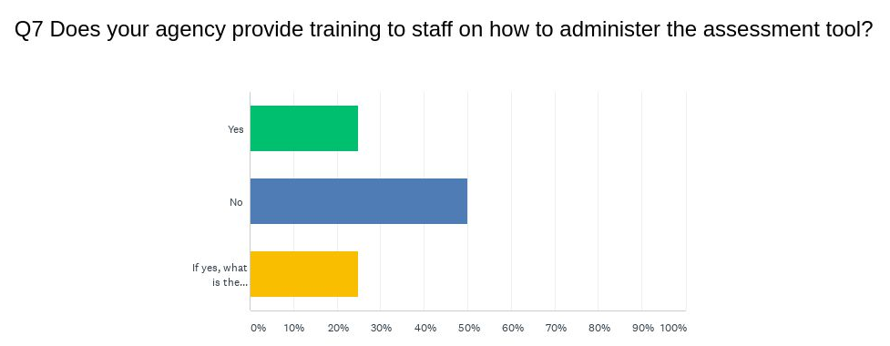
Suicide training CEUs once every 2 years for licensing
Safe-T at hire and annually
Columbia
LI & LII Suicide training ongoing

Slide 23
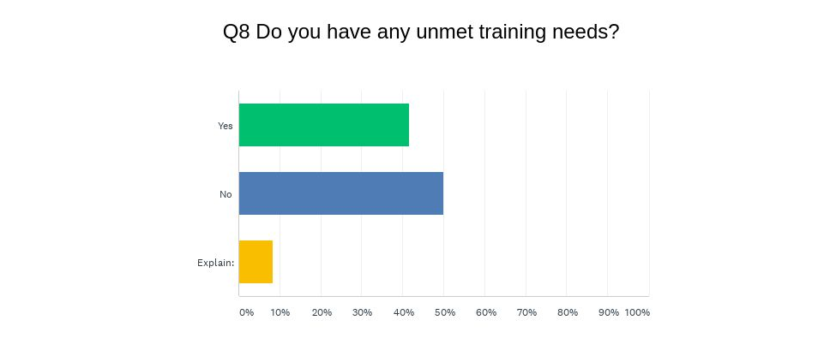
* 1 agency would like further assessment regarding agency training needs.

Slide 24
Trainings
Garrett Lee Smith Grant
  Attachment-based Family Therapy by Drexel University
    May 28th and May 28th
Jason Foundation: First Responder Training
  May 18th
Treating Suicidal Patients During COVID-19: Best Practices and Telehealth
  Webinar is available on http://www.bc-systemofcare.org/
LOTS of additional trainings webinars are available!!

Slide 25
World Suicide Prevention Day
September 10, 2020
Send us you ideas
Does your agency already have plans?
Suicide: The Ripple Effect
  screenings have been placed on hold

Slide 26
What can we do to help?
E-mail us:
Elisia Majors
emajors@bcbh.org
Stephanie Santoro
SSantoro@AHCI.org
Bonnie Palmieri
bpalmieri@ahci.org

Slide 27
Resources
The Mental Health Support Line
Developed on April 1st
Can be reached toll-free, 24/7 at 1-855-284-2494 from anywhere in PA.
Crisis Text Line
Text PA to 741-741
PA Get Help Now Helpline
Can be reached toll-free at 1-800-662-HELP (4357).
A live chat option is also available online or via text message at 717-216-0905
Warmline of Beaver County
Can be reached at 1-877-775-WARM (9276)
Hours of operation were extended:
  Monday through Friday, 12pm until 9pm
  Saturday through Sunday, 6pm until 9pm
UPMC Beaver County Crisis
Can be reached toll-free, 24/7 at 1-800-400-6180

Slide 28
PA Resources
Many other resources also remain available to Pennsylvanians in need of support, including:
  National Suicide Prevention Lifeline: 1-800-273-TALK (8255)
  Línea Nacional de Prevención del Suicidio: 1-888-628-9454
  Crisis Text Line: Text “PA” to 741-741
  Safe2Say: 1-844-723-2729 or www.safe2saypa.org
  Veteran Crisis Line: 1-800-273-TALK (8255)
  Disaster Distress Helpline: 1-800-985-5990
  Get Help Now Hotline (for substance use disorders): 1-800-662-4357

Slide 29

Thank you!!
Thank you!!
Thank you!!

