Slide 1
Beaver County Behavioral Health
System of Care Orientation
Beaver County, PA

Slide 2
System of Care (SOC) Orientation - Overview
Welcome
What is the System of Care?
SOC Vision
SOC Dimensions
Who makes up the System of Care?
How is the System of Care organized?
Participating in the SOC
Questions

Slide 3
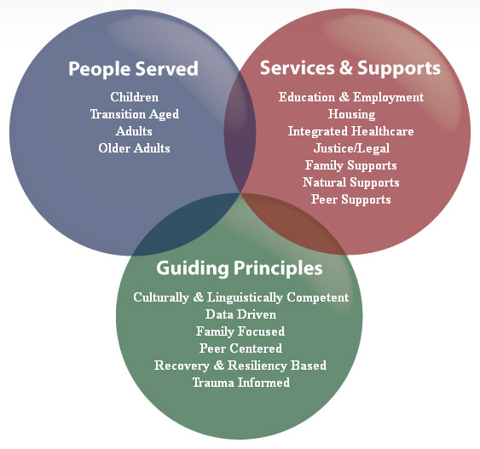
What is the System of Care?
A framework and philosophy
Works to expand services and improve access
Coordinates care among agencies
Involves the community and natural supports
Notes:
The “system of care” is a framework and philosophy that involves collaboration across agencies and community-based services to help adults, youth, and families achieve a successful recovery from mental health and substance abuse challenges.
The “system of care” works to expand services and improve access by coordinating agency and community-based care and involving natural supports.

Slide 4
System of Care Vision
Easily accessible
Welcoming, effective, and efficient
Inspires hope
Based on the needs of the individual
Those with lived experience have the opportunity for maximum recovery.
Notes:
All people can easily access a welcoming, effective, and efficient system of care that inspires hope, and integrates treatment based on the needs of the individual, not the needs or convenience of the system.
Individuals and families with lived experience have the opportunity for maximum success toward recovery or improved lifestyle.

Slide 5
System of Care – 3 Dimensions
People Served
Services and Supports
Guiding Principles

Slide 6
People Served
Children
Youth and Young Adults
Adults
Older Adults

Slide 7
Services and Supports
Education & Employment
Housing
Integrated Healthcare
Justice/Legal
Family Supports
Natural Supports
Peer Supports

Slide 8
Guiding Principles
Culturally & Linguistically Competent
Community-Based
Family-Driven and Youth-Guided
Data-Driven
Educated, Trained and Skilled Workforce
Notes:
Culturally and Linguistically Competent by being responsive to the cultural, racial, and ethnic differences of the populations served.
Community-Based by putting people and communities at the center of the system, ensuring that services and supports are available and accessible. This includes providing safe, affordable housing as well as utilizing natural supports.
Family-Driven and Youth-Guided by concentrating on not just the individual but rather the individual and those surrounding and supporting the individual.
Data Driven by using research and data to improve care and plan next steps.
Effective and productive through development of a trained and skilled workforce with increased Education and Employment options.

Slide 9
Guiding Principles
Integrated Physical and Behavioral Healthcare
Co-Occurring Disorders and Other Complex Needs
Peer-Centered
Trauma-Informed
Recovery and Resiliency-Based
Notes:
Coordinated in our efforts to increase awareness and stress the importance of Integrated Physical and Behavioral Health Care.
Understanding and welcoming to families and individuals with Co-Occurring Disorders and Other Complex Needs. Working together, the SOC will strive to offer services that are accessible, integrated, seamless and comprehensive.
Peer-Centered by focusing on helping each person to achieve the most satisfying life possible, encouraging assistance from peer mentors and other peer support.
Trauma-Informed by increasing awareness of trauma and to build a workforce capable of providing trauma-informed care.
Recovery and Resiliency-Based by putting individuals and families in the middle of the conversation and building services and supports around their vision for a happy, meaningful life.

Slide 10














Who is the System of Care?
Certified Peer Support
Specialists
Family
Members
You!
Hospitals
Youth
Ambassadors
Mental Health
Advocates
Outreach
Recovery
Coordinators
Mental & Physical Health
Providers
Community Supports, Natural Supports
Educators
Law
Enforcement
People Served
and Partner Providers
Criminal Justice System
Vocational and Employment Providers

Slide 11
Organizational Chart
Residents of Beaver County
Beaver County
Board of Commissioners
Beaver County Human Service Departments
Leadership Committee
Change Agents
Adult, Family, Youth and Peer Voice
Steering Committee
Housing and Homeless Committee
Justice- Related Services
Child & Adult-serving Systems
Employment
Transformation
Quality Improvement
Drug Abuse Coalition
Stakeholder Group

Slide 12
Benefits of participating in the SOC
Learn what is happening in behavioral health treatment
Develop personal and professional relationships
Network and collaborate
Advocate
Access to free training and continuing education
Access to County leadership
To evaluate system performance
Notes:
To learn what is happening in mental health and substance abuse treatment; locally and across the nation
To develop personal and professional relationships
To establish referral paths and linkages between agencies
Opportunities for formal and informal networking and collaboration
To learn how to better advocate for self or for others
To gain access to free training and continuing education
To participate in County-level SOC Steering Committee and SOC Workgroups
To have a voice in service design–budget decisions
To evaluate system performance

Slide 13
Where can you participate?
SOC Committees:
Change Agents
Steering Committee
Housing and Homeless Committee
Employment and Transformation
Justice-Related Services
Child Serving Systems
Quality Improvement
Drug Abuse Coalition

Slide 14
Next Steps - Find out more about the SOC…
Attend a Committee/Subcommittee Meeting
Contact us on the SOC website:
www.bc-systemofcare.org
Visit us on Facebook:
Beaver County System of Care (SOC)
Attend the annual Public Hearing / Stakeholder Meeting

Slide 15
Questions?
Contact the Recovery Coordinator
with any questions, or to request
Peer Support:
Bonnie Palmieri
bpalmieri@ahci.org
724.624.7203

